Slide 1
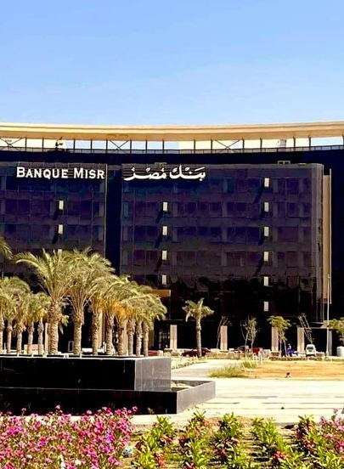
BANQUE MISR ORACLE GLOBAL HCM
>>>

Slide 2

Team Members

Slide 3
.
Esraa Ibrahim Mohamed (Set up and Work structure)
D. Mohamed Omar Abdul Fatah (People Management)
Kamla Medhat El-hoseny (Payroll)
Mustafa Sami Mohamed (Payroll)

Slide 4
Content
Setup the ERP
Create Work Structure
Create People Management
Create and Organize Payroll

Slide 5
Setup the ERP
Create user
Create Responsibility
Add Responsibilities to the user

Slide 6
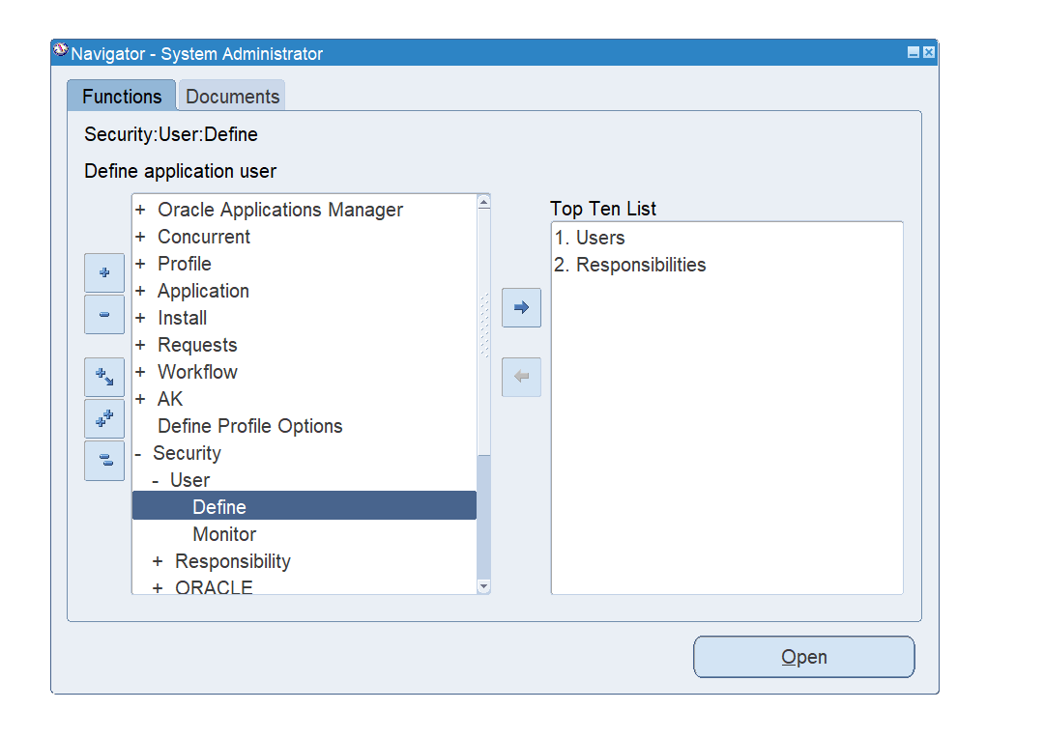
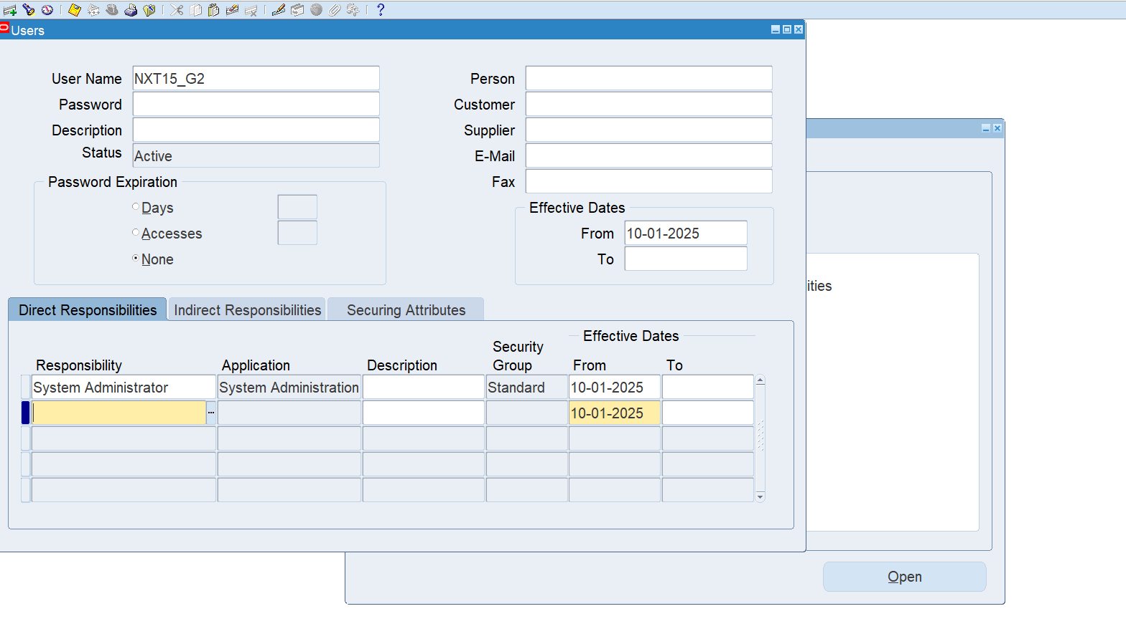
Create user
Path: System Administrator >Security >user >define
User name: NXT15_G2

Slide 7
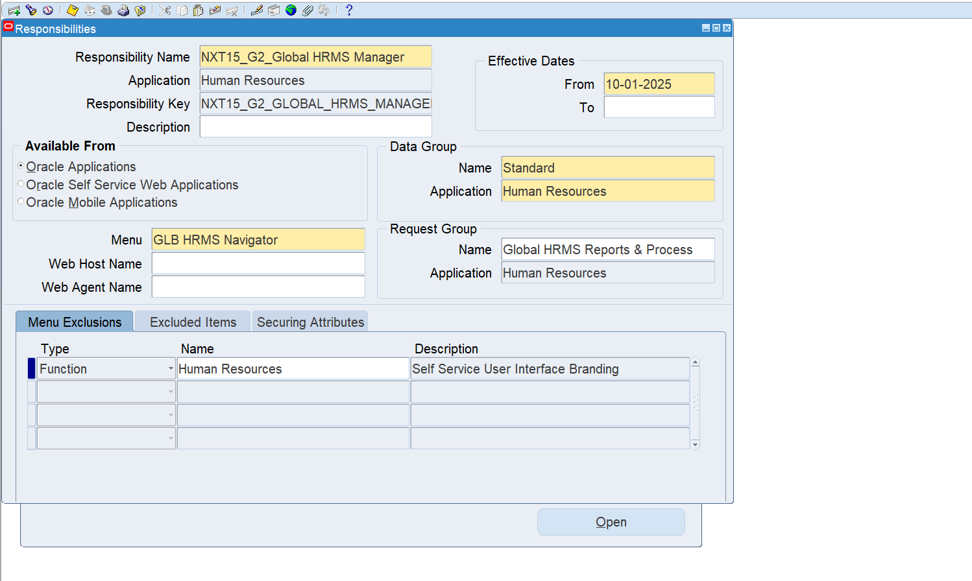
2.Create responsibility
Path: System Administrator >Responsibility
Responsibility Name:
NXT15_G2_Global HRMS Manager

Slide 8
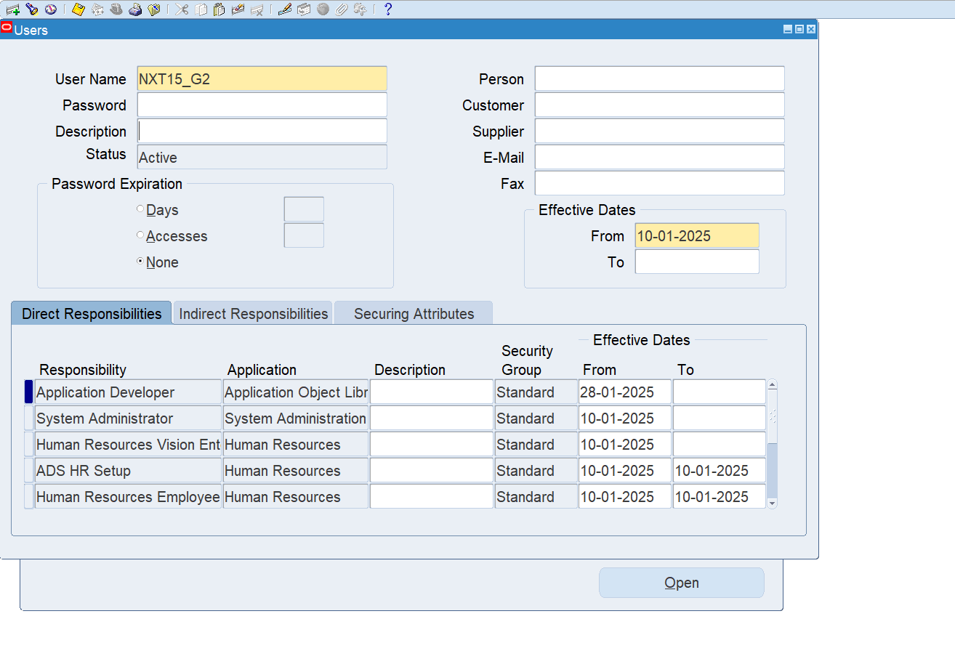
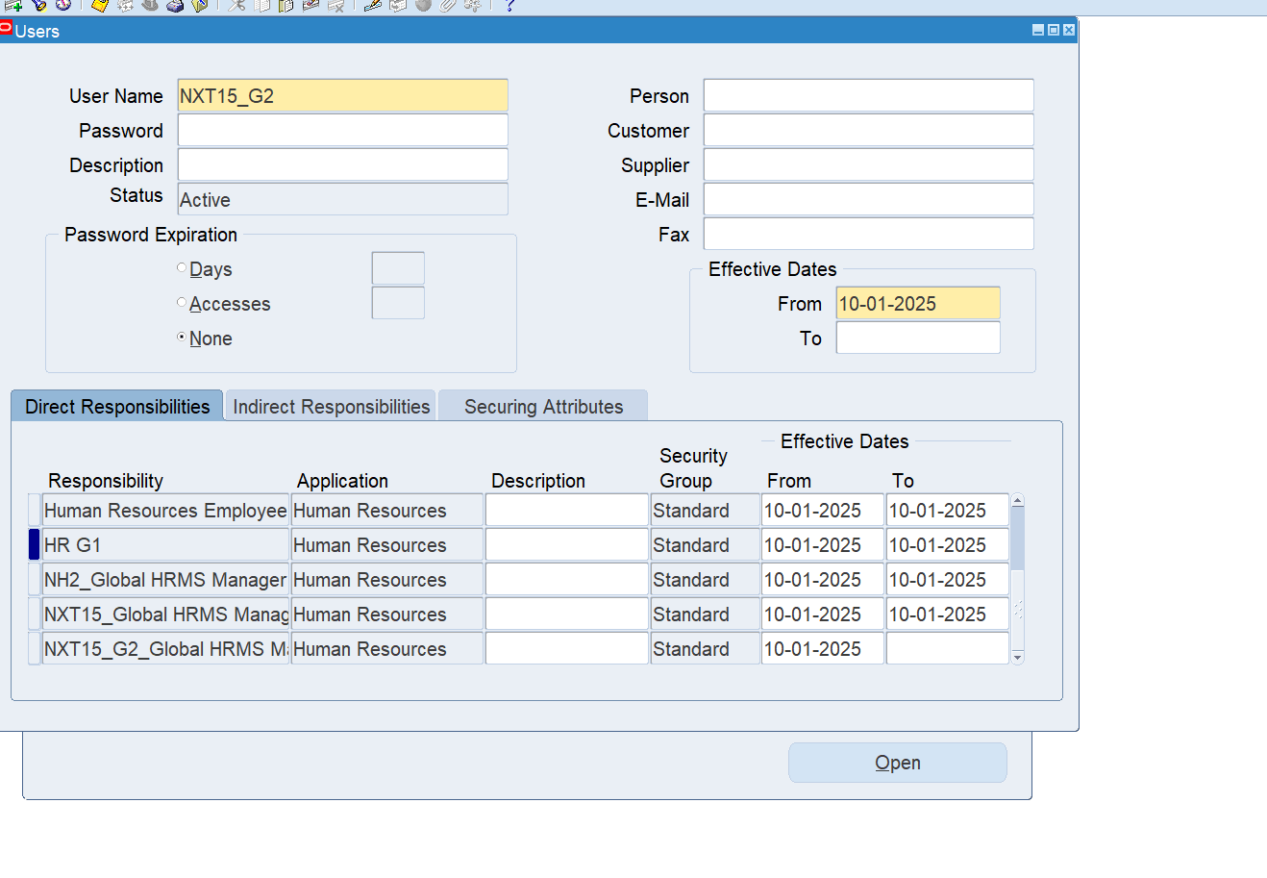
3. Add Responsibilities to the user
Path: System Administrator >Security >user >define
Responsibilities:
-Application Developer
-System Administrator
-Human Resources Vision Enterprises
-NXT15_G2_Global HRMS Manager

Slide 9
2) Create Work Structure
Create 6 Flex field
Create Value set for the 6 flex fields
Add data to value set
Create Business Group
Link Business Group to Responsibility
Run Request
Create and Define Organization
Define the 6 flex fields

Slide 10
The 6 Flex field
Human Resources:
Job
Grade
Position
Competence
Payroll:
People group
Cost Allocation

Slide 11
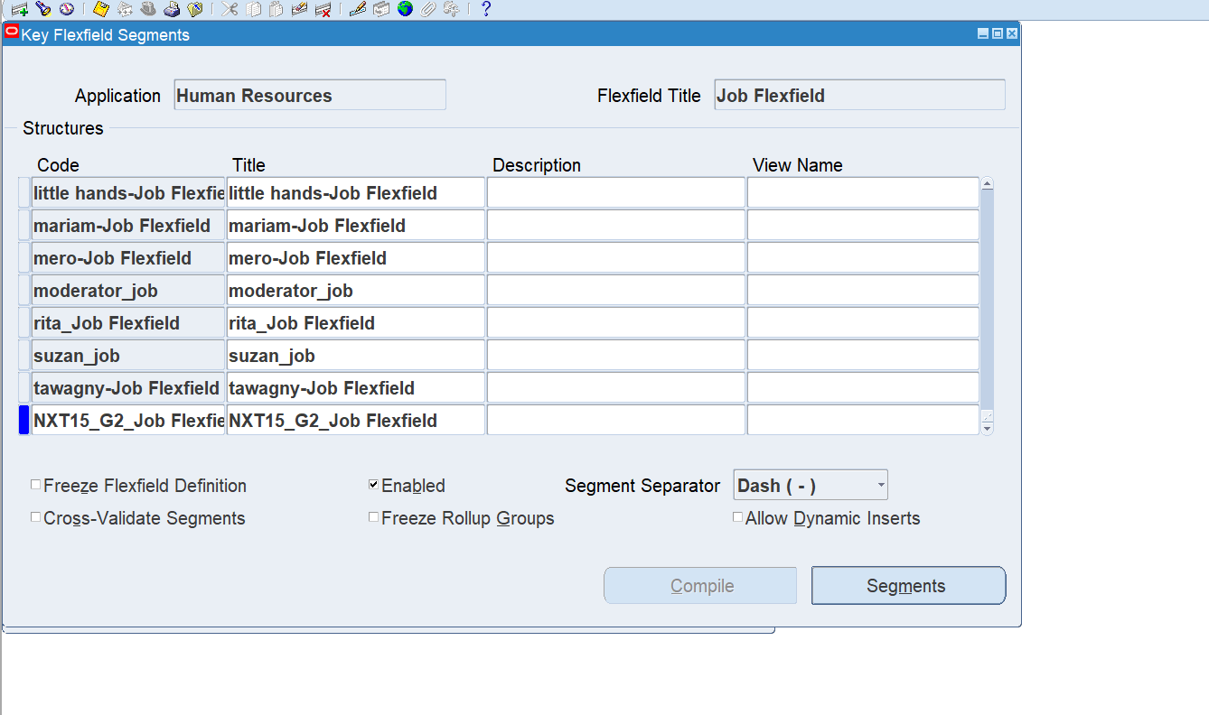
1.Create 6 fix field
Path: System Administrator >Application > Flex field> key> segment
Job Flex field Name:NXT15_G2_Job Flex field

Slide 12
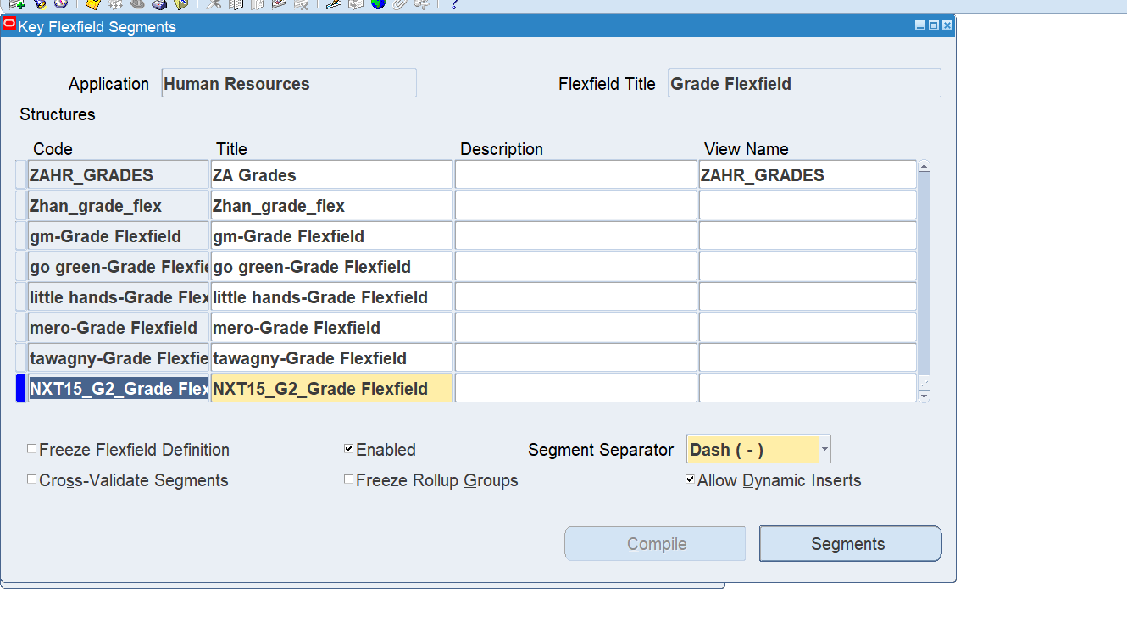
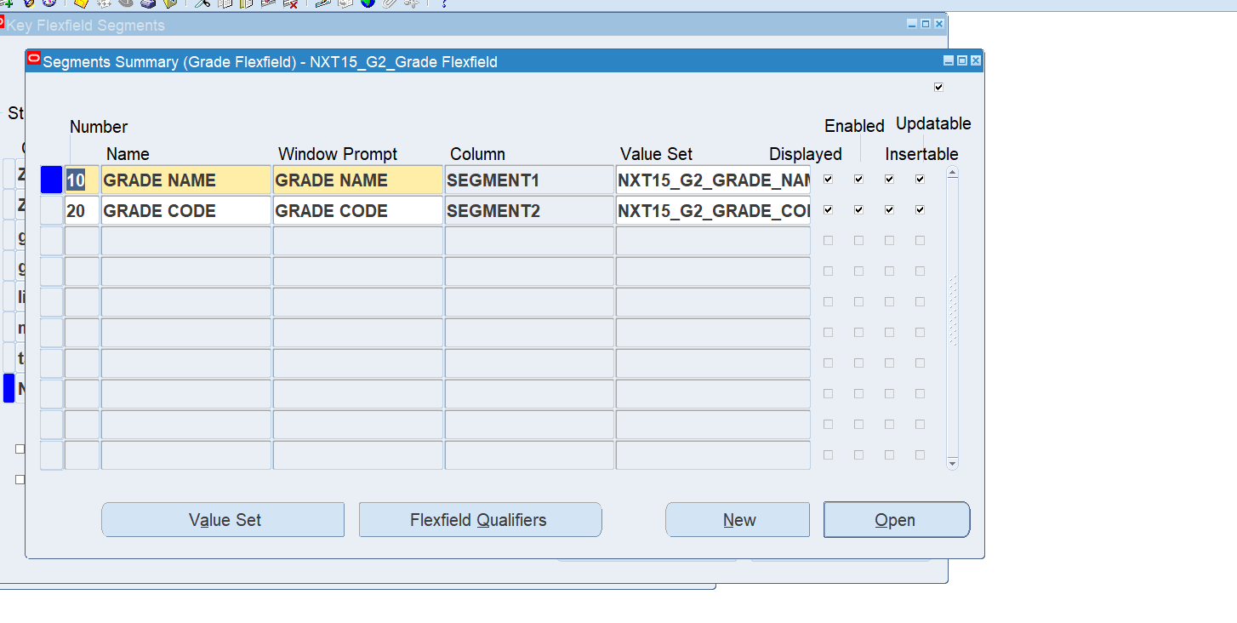
Grade Flex field Name:NXT15_G2_Grade Flex field
Grade Flex field Segments:
GRADE NAME (SEGMENT1)
GRADE CODE (SEGMENT2)

Slide 13
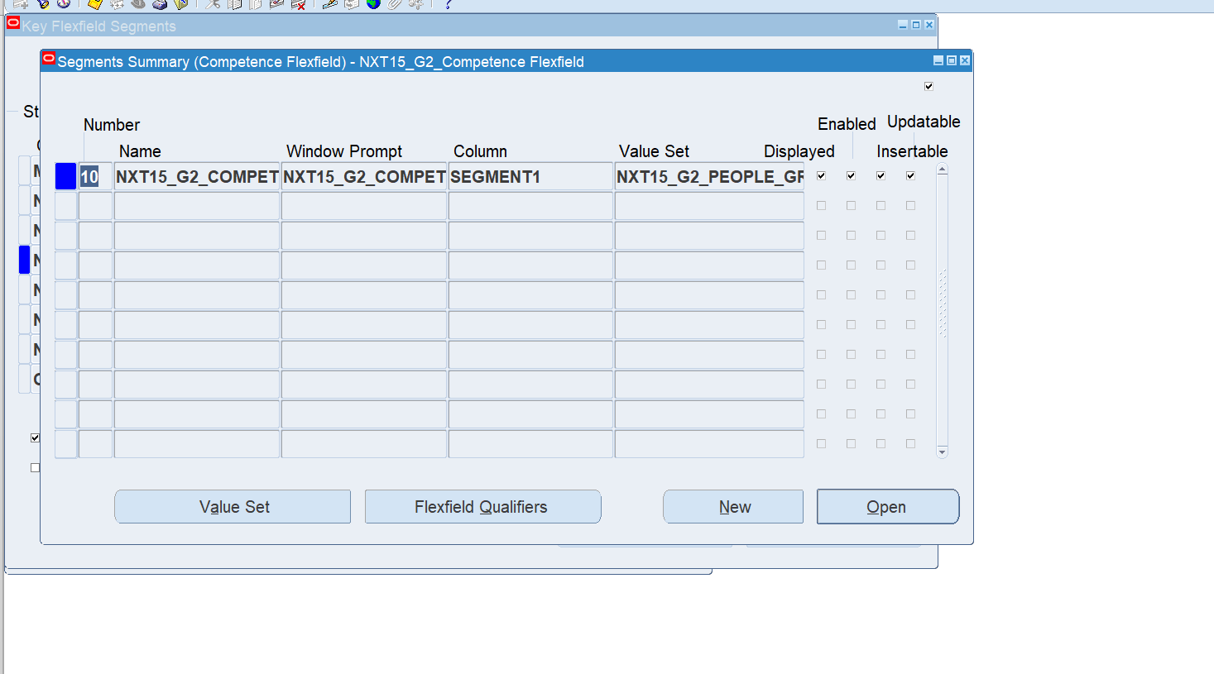
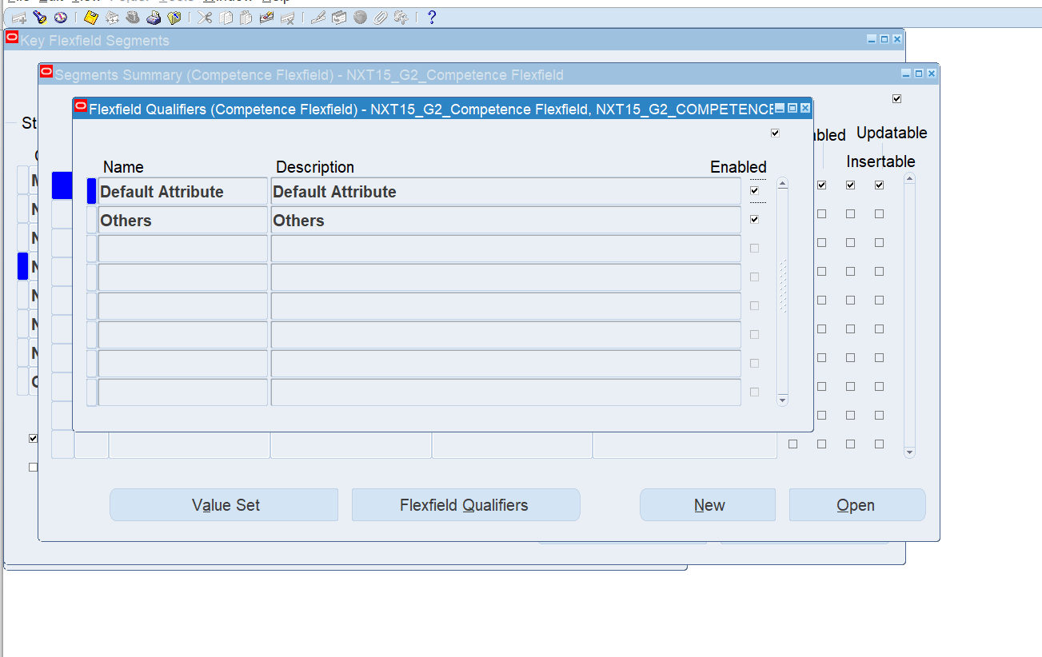
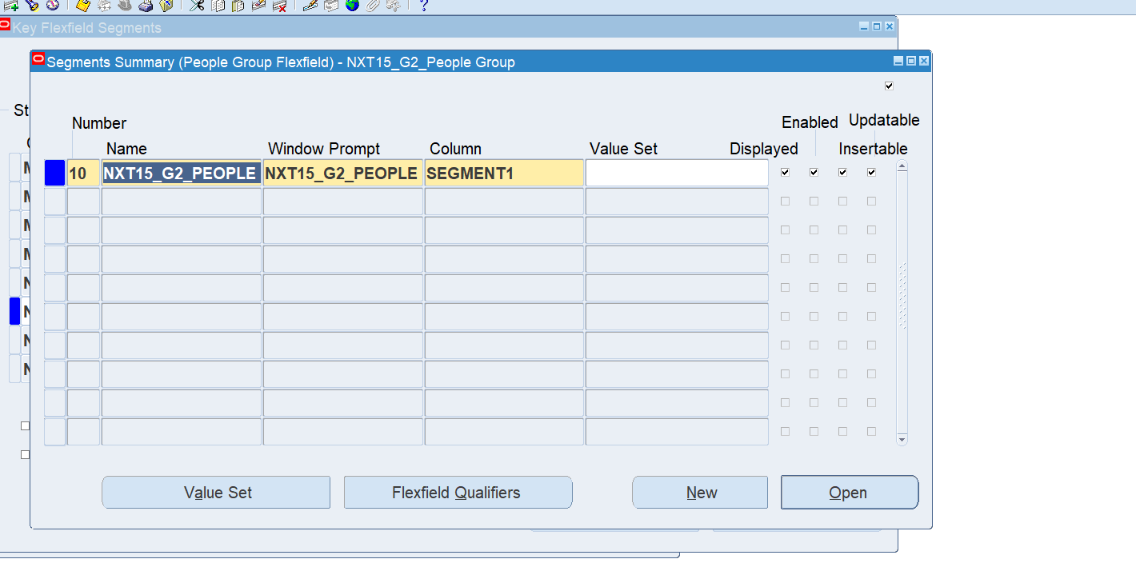
People group Flex field Name:NXT15_G2_People group Flex field
Competence Flex field Name:NXT15_G2_ Competence Flex field
Flex field qualifiers

Slide 14
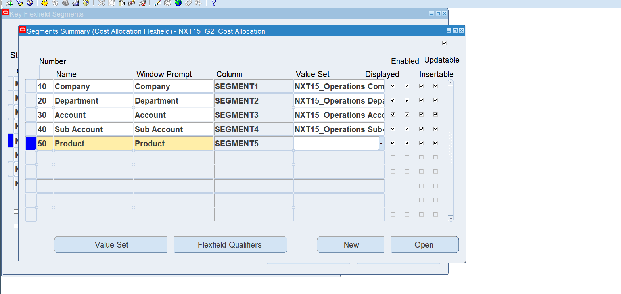
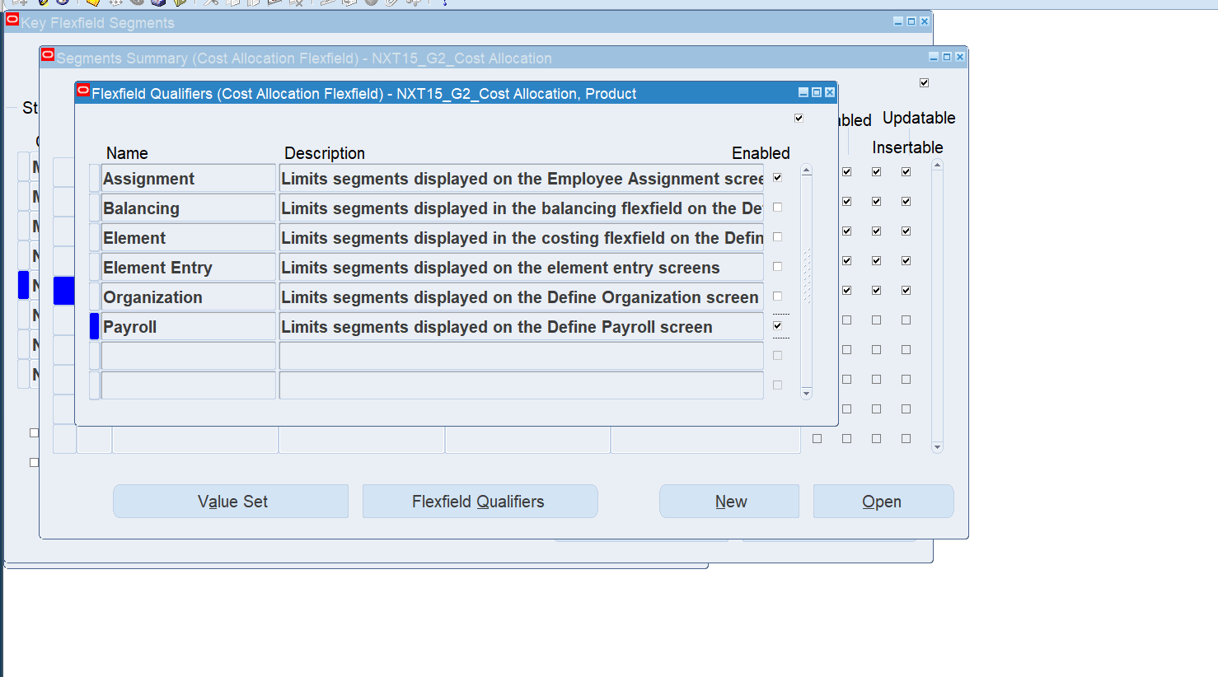
Cost Allocation Flex field Name:NXT15_G2_Cost Allocation Flex field
Flex field Segments:
Company
Department
Account
Sub Account
Product
Flex field qualifiers

Slide 15
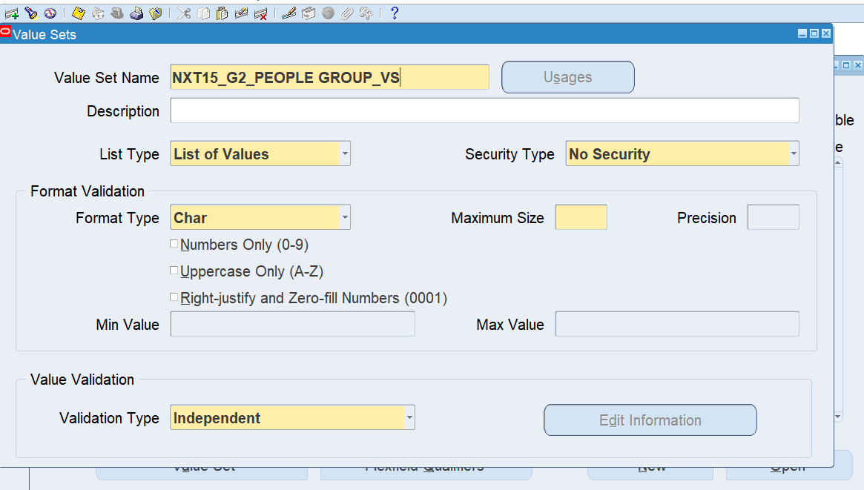
2. Create Value set for 6 flex fields
Path: System Administrator >Application> Validation >Set
Value set name:NXT15_G2_ PEOPLE GROUP_VS

Slide 16
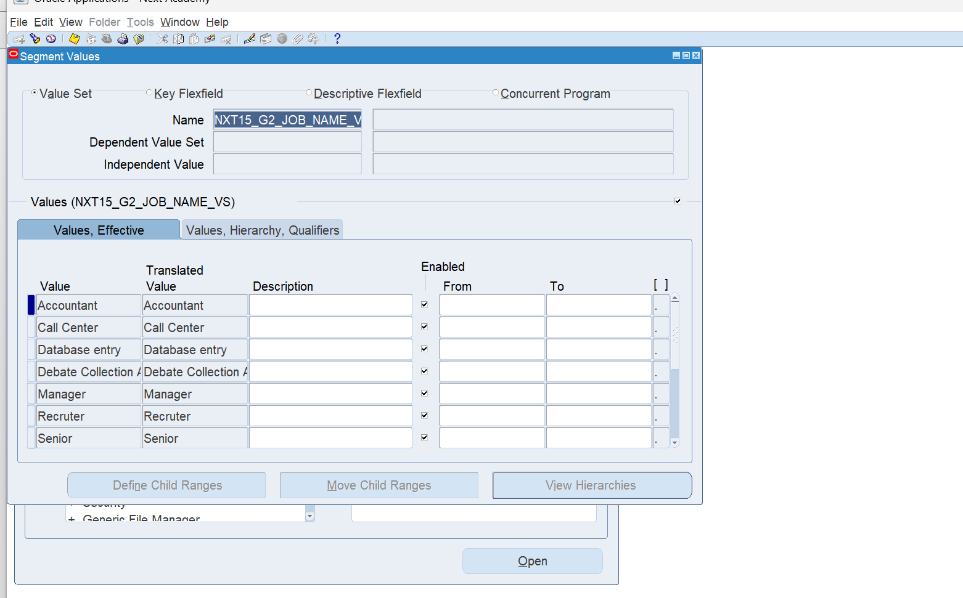
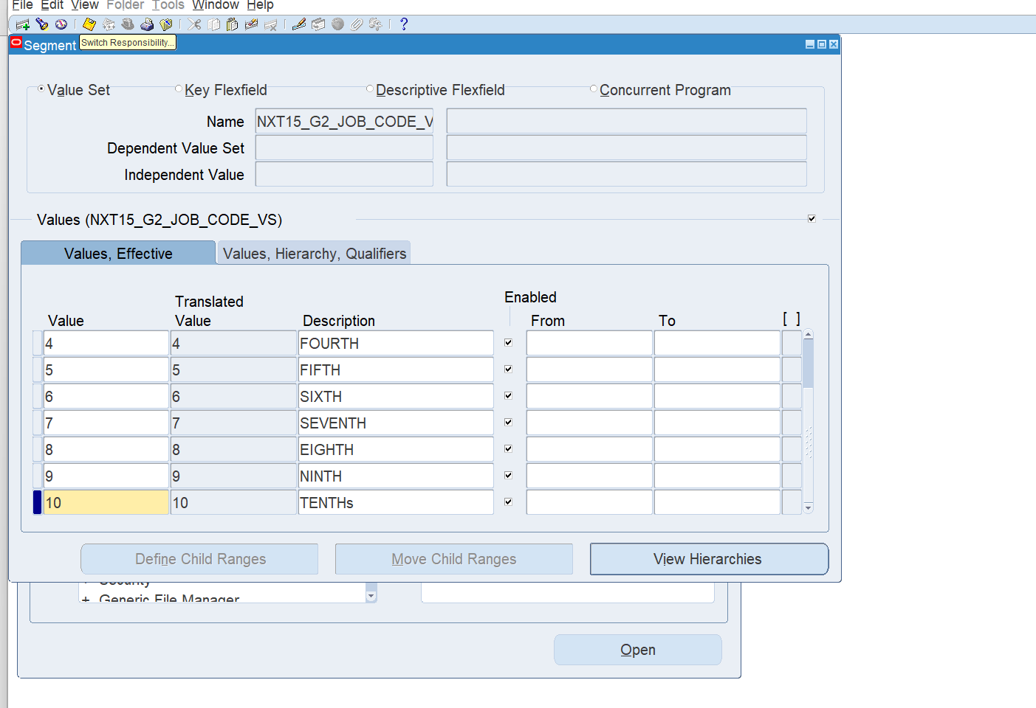
3. Add Data to Value set
Path: System Administrator >Application> Validation >Value
Job name value set:NXT15_G2_JOB_ NAME_VS
Job code value set:NXT15_G2_JOB_ CODE_VS

Slide 17
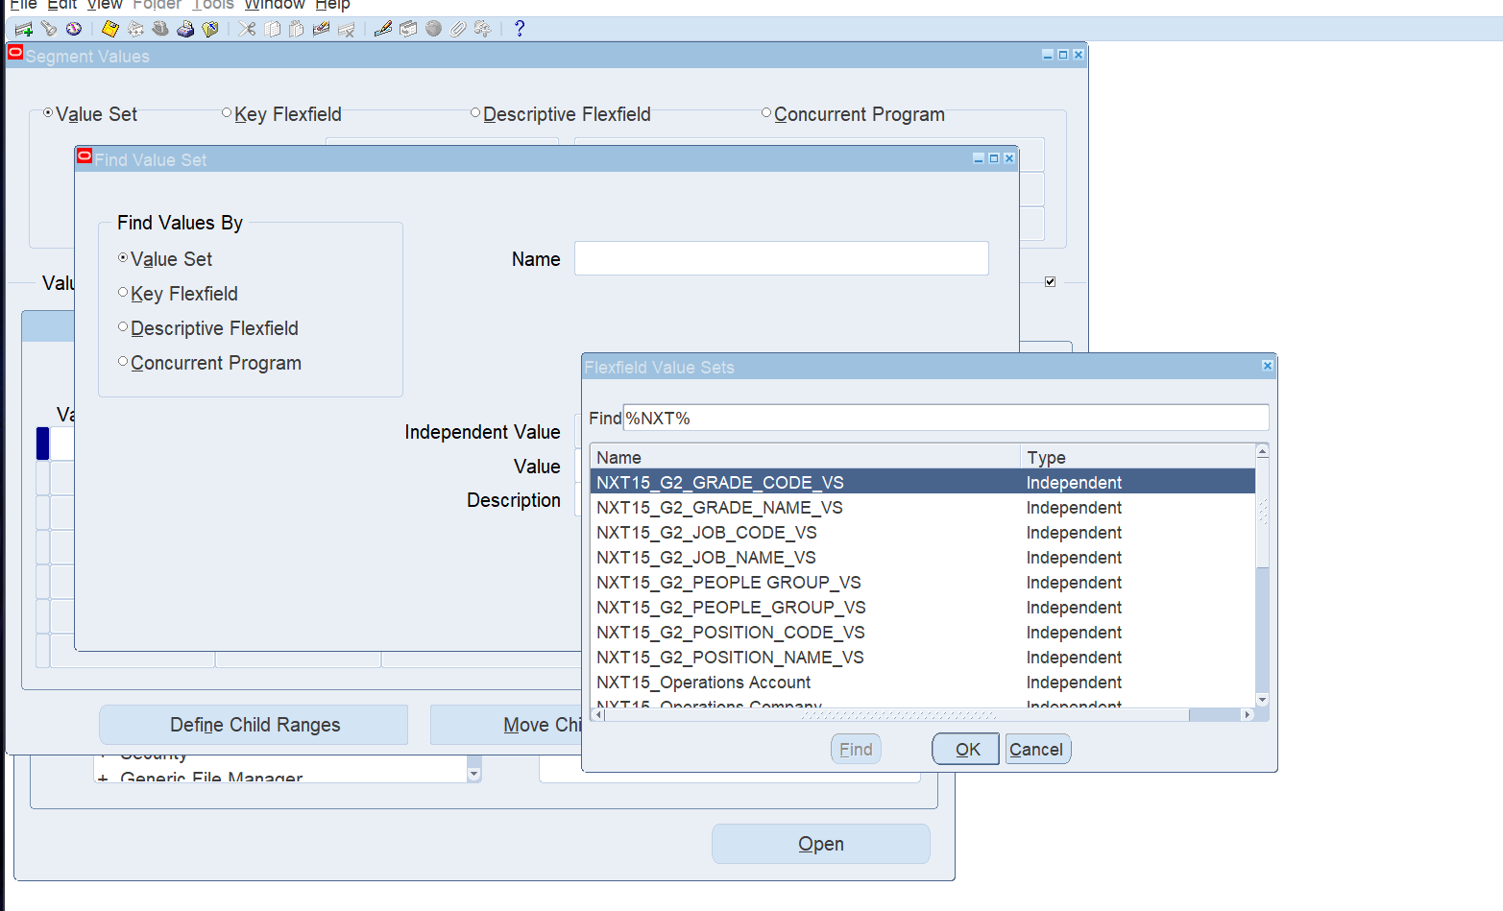
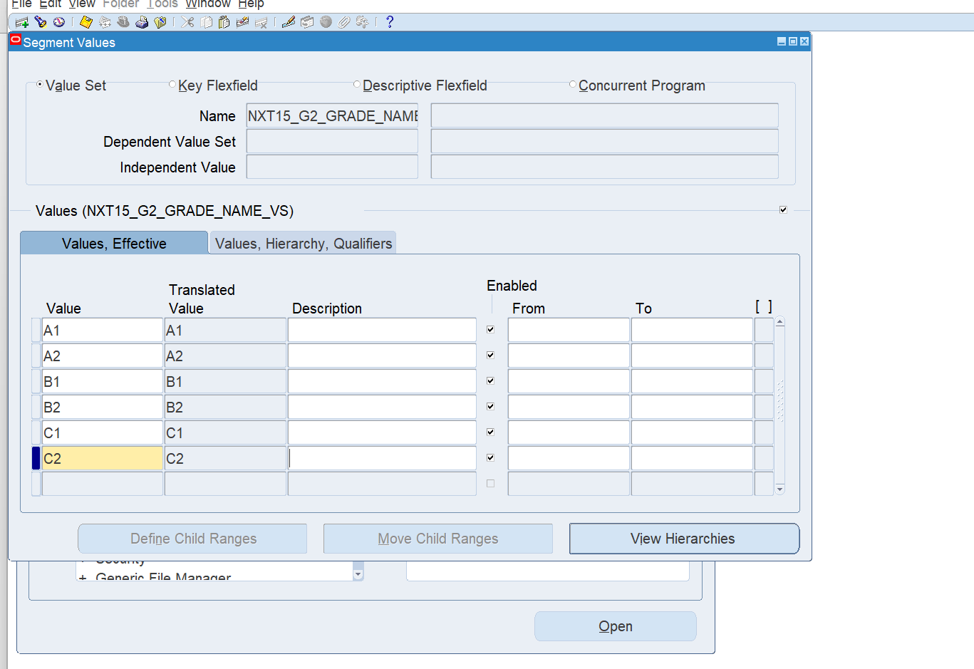
Path: System Administrator >Application> Validation >Value
Grade name value set:NXT15_G2_ GRADE_NAME_VS

Slide 18
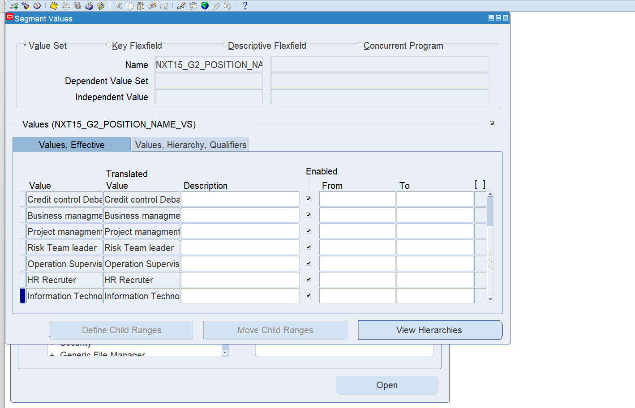
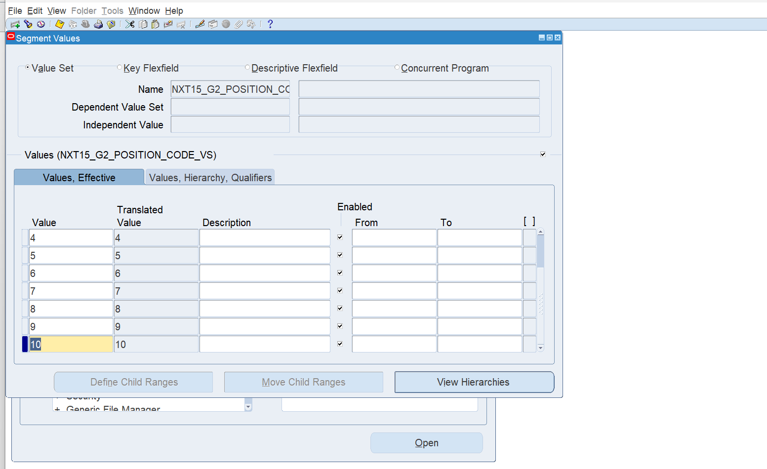
Position name value set:NXT15_G2_ POSITION _NAME_VS
Position code value set:NXT15_G2_ POSITION _CODE_VS

Slide 19
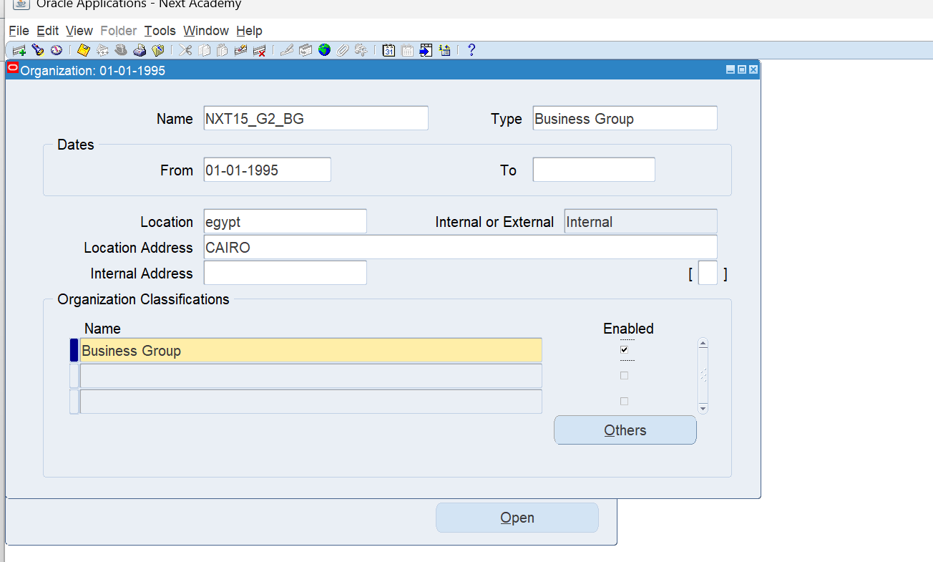
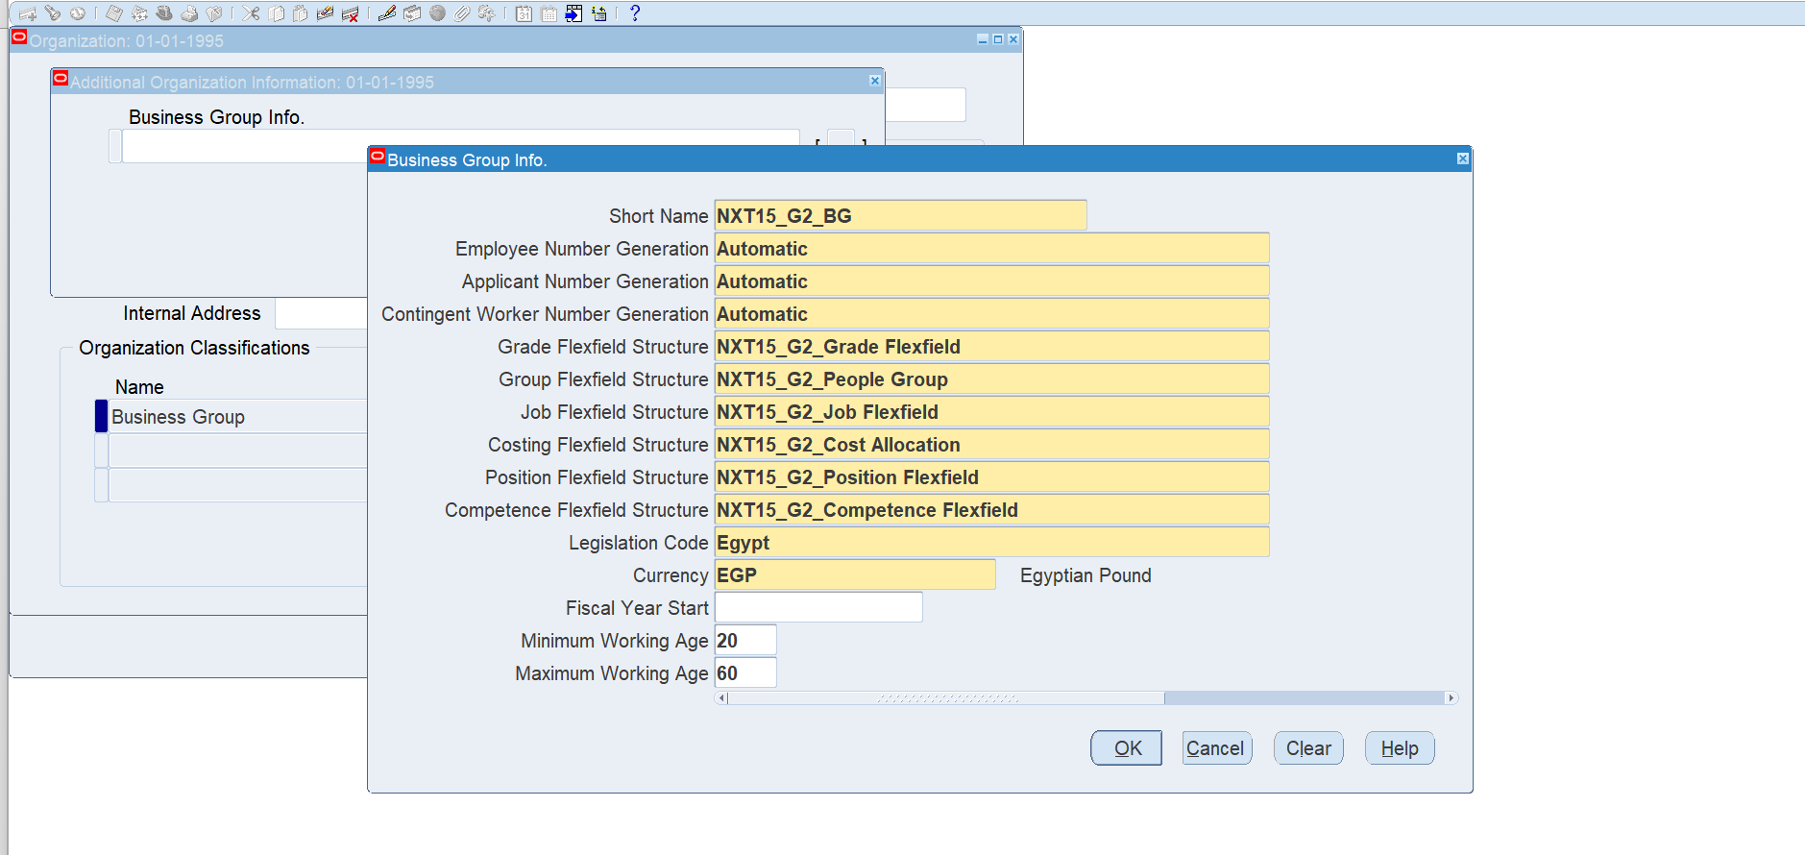
4.Create Business Group
Path: Work Structure >Organization> Description
Business Group name: NXT15_G2_BG

Slide 20
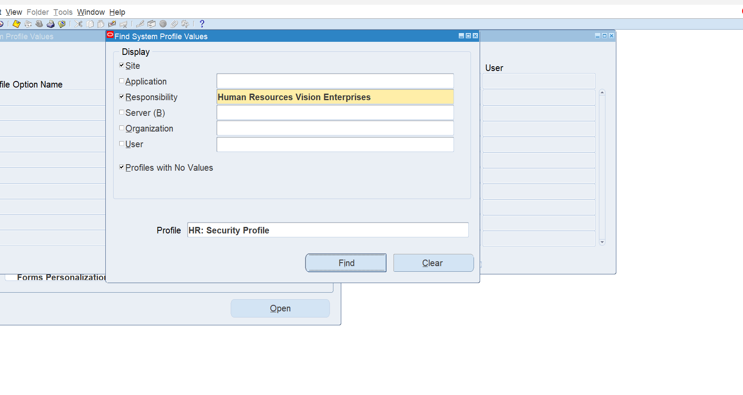
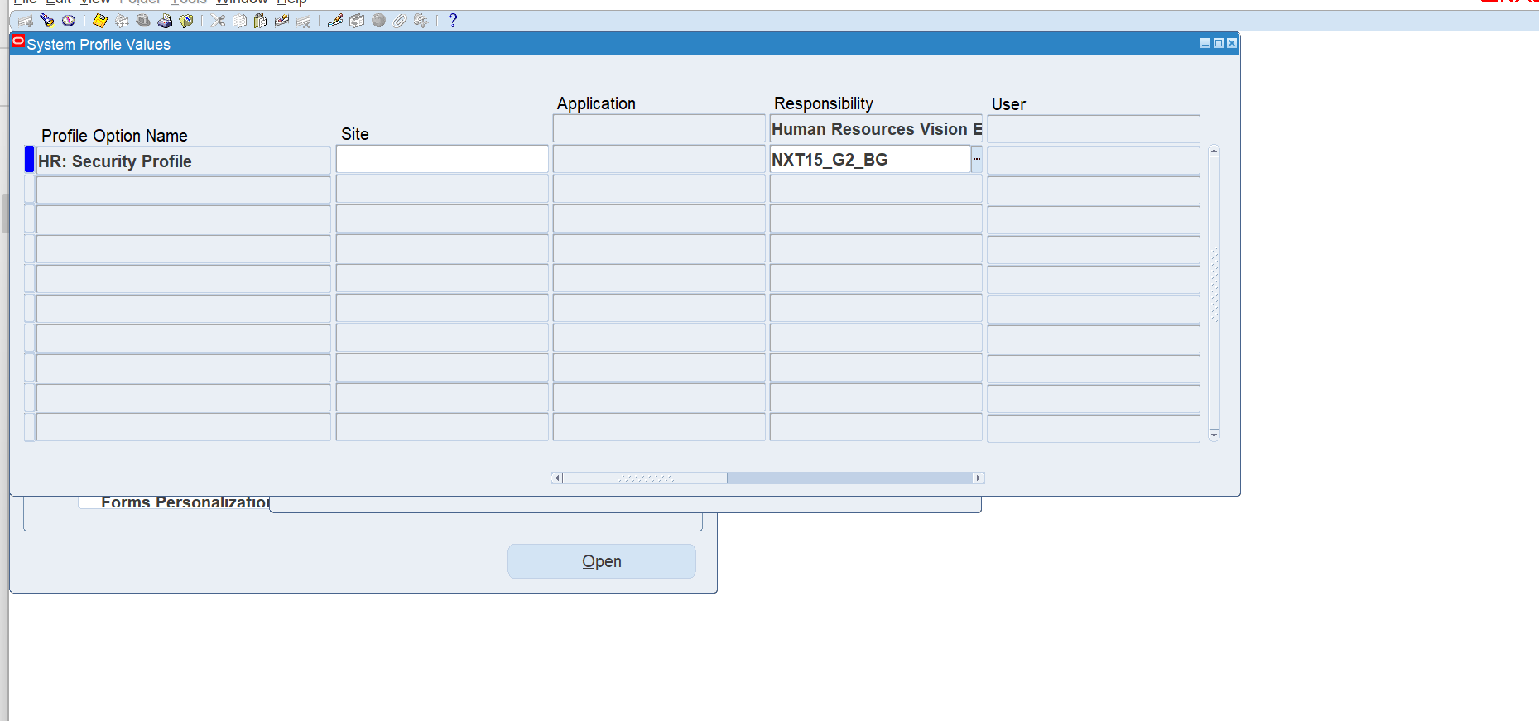
5.Link Business Group to Responsibility
To link Business group to the Responsibility ,We must create TWO Profiles options.
Path: Profile>System
Profile: HR: Security Profile
Responsibility:
-NXT15_G2_BG

Slide 21
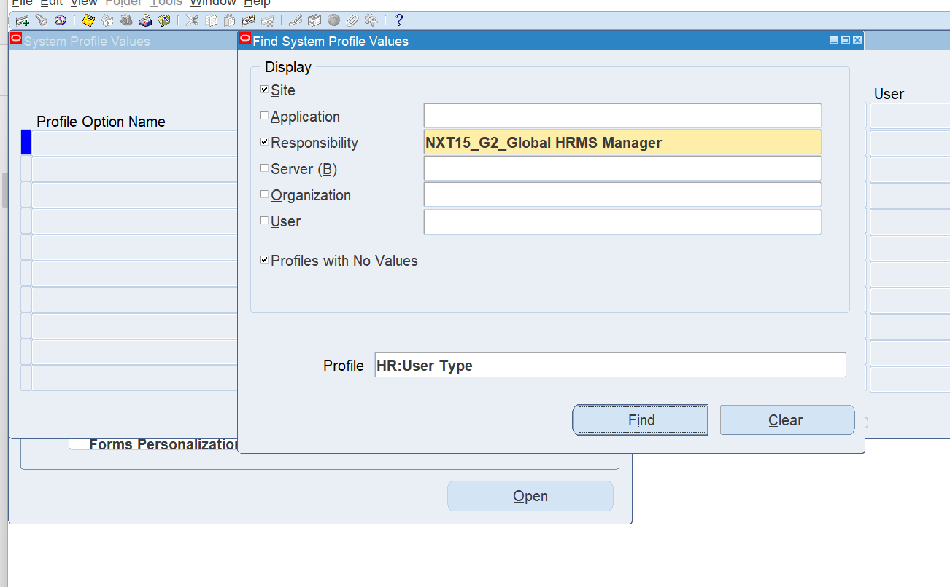
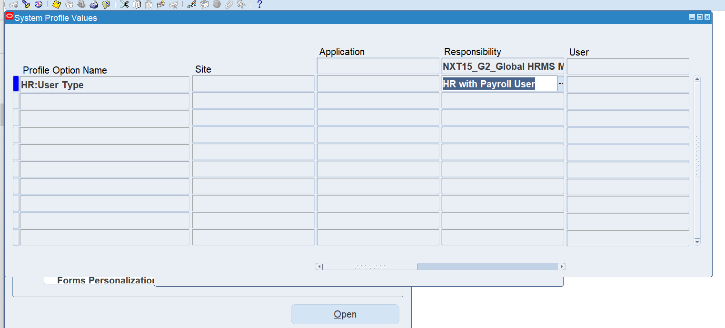
2) Profile: HR: User Type
Responsibility:
-NXT15_G2_Global HRMS Manager
-HR with Payroll User

Slide 22
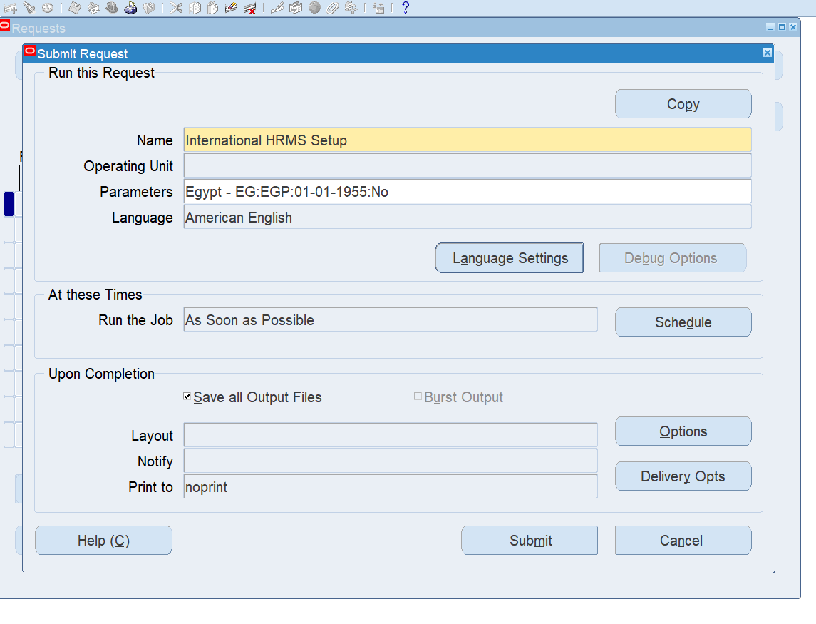
6.Run Request
Path: View> Requests >submit a new request
Request name :
International HRMS Setup

Slide 23
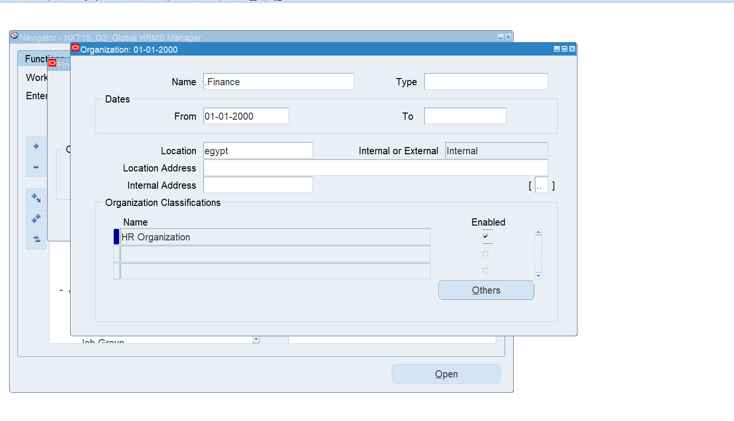
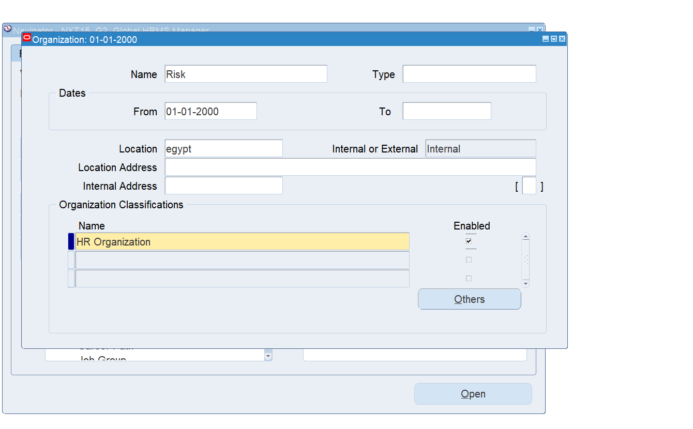
7.Create and Define Organization
Path: Work Structure >Organization> Description
Organization name:
-Finance
-Risk

Slide 24
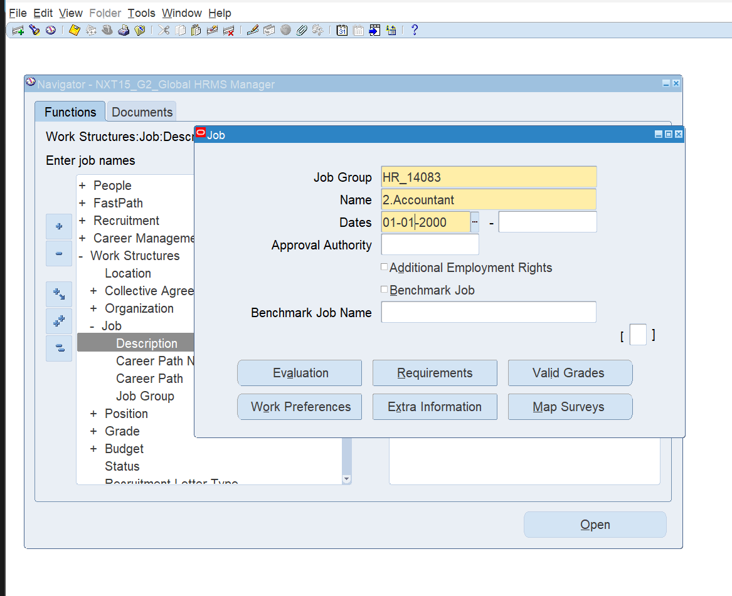
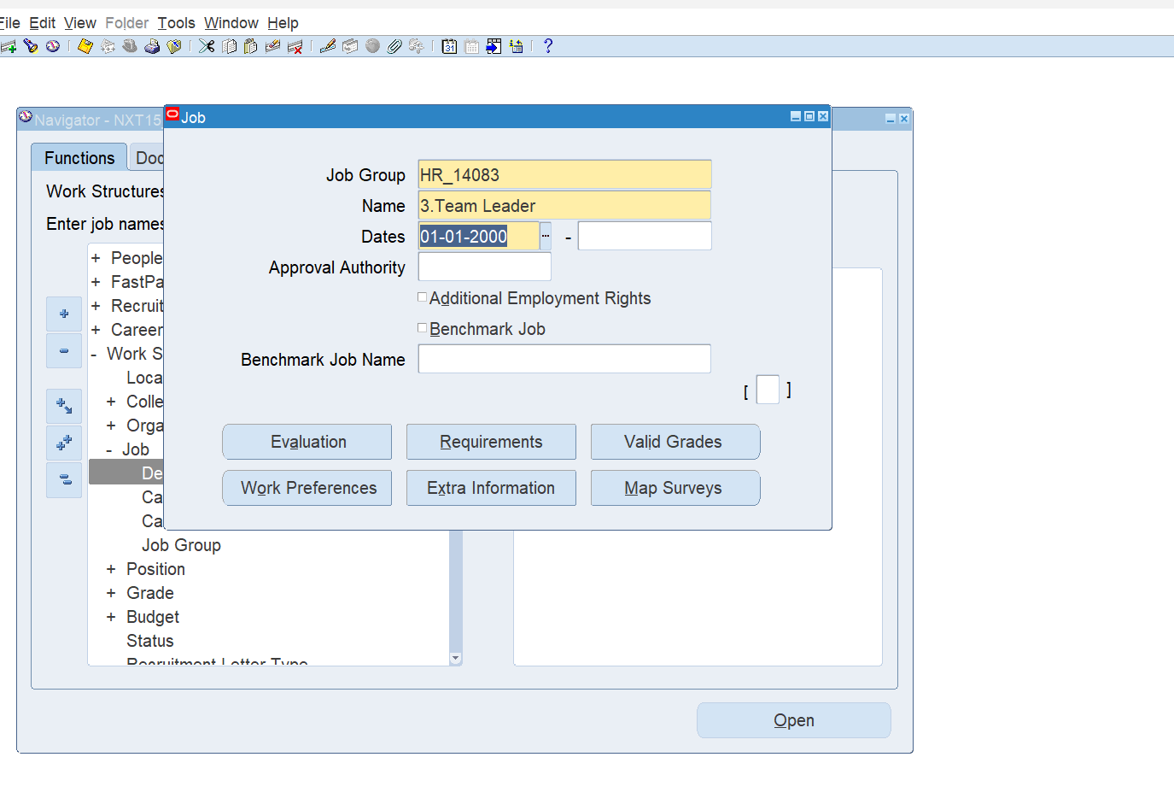
8.Define the 6 Flex fields
Path: Work Structure >Job> Description
Job name:
-Accountant
-Team Leader

Slide 25
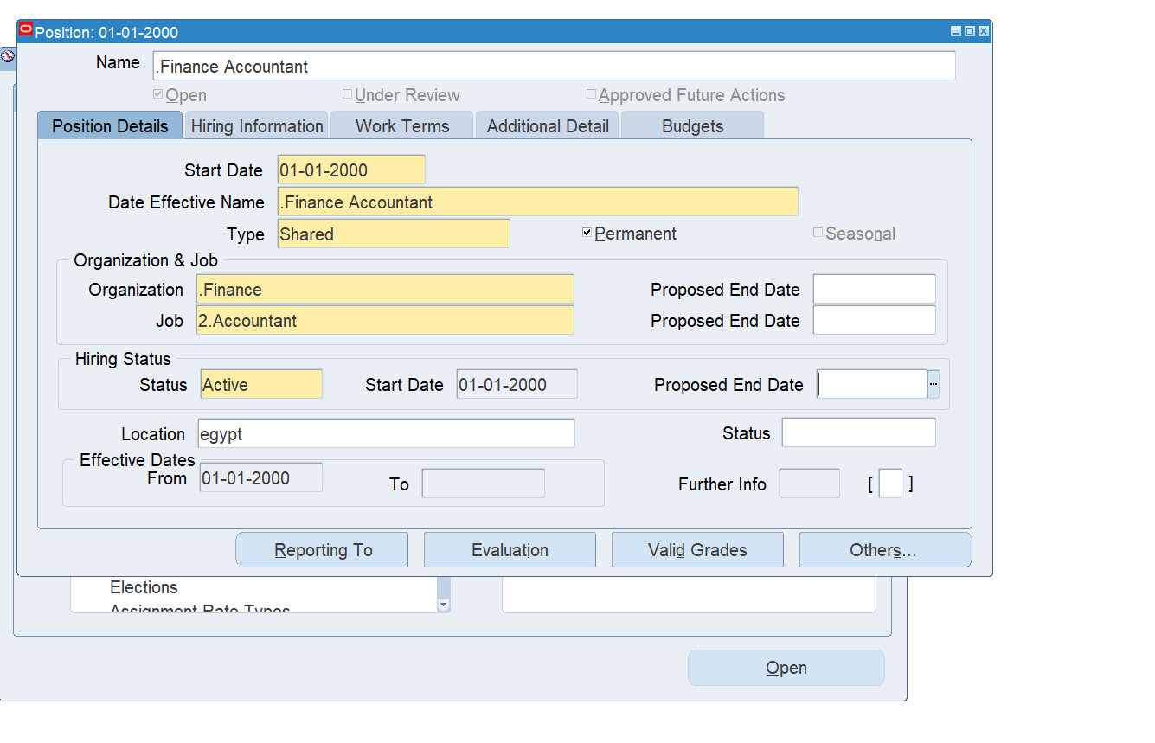
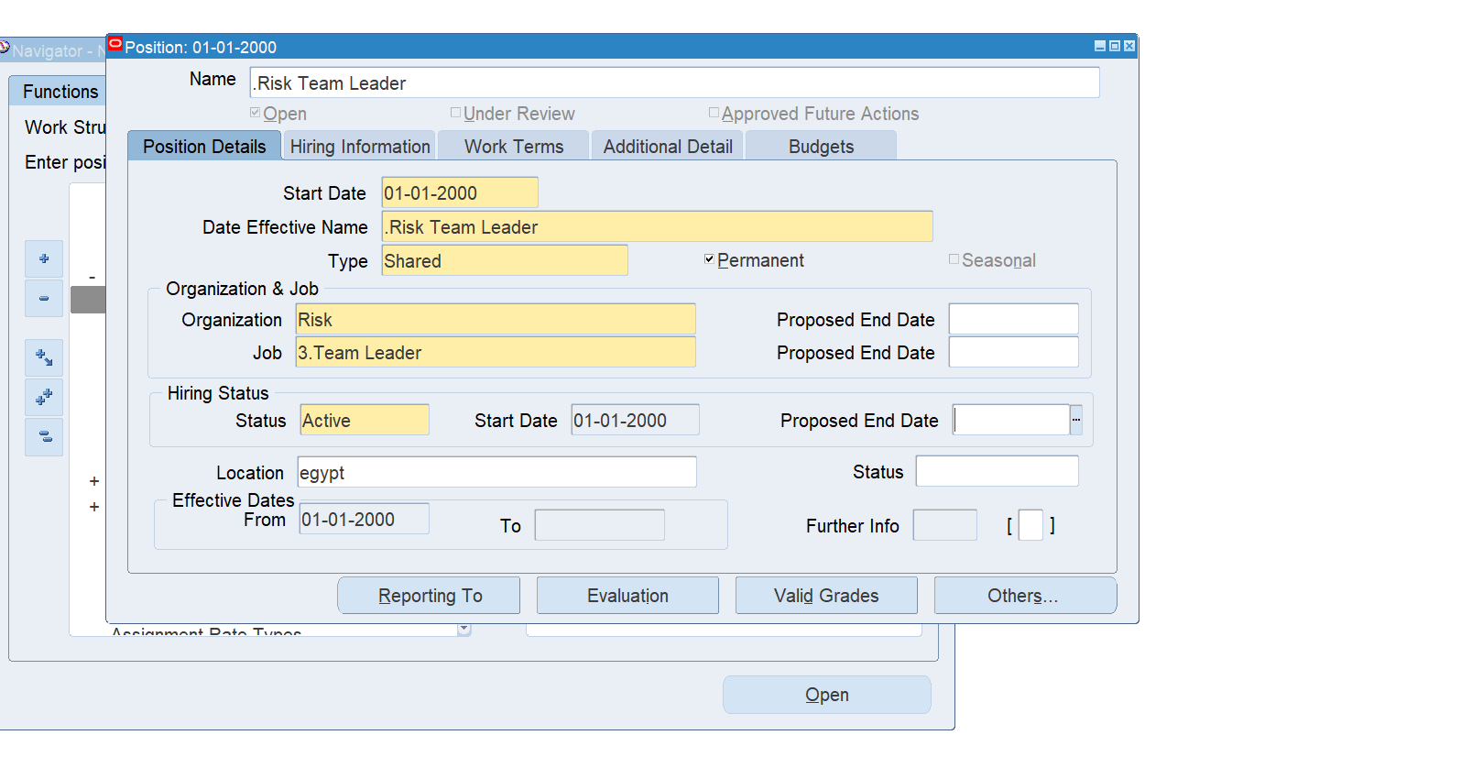
Path: Work Structure > Position > description
Position= Organization+ Job
Position name:
-Finance Accountant
-Risk Team Leader

Slide 27

3.People Management
new employees
assignment
address contact
special information
others phone, contact, qualification

Slide 28
1- New employees
Name | Age
Mohamed Sayed Ahmed | 45
Nada Omar Mohamed | 25
Omnia Mohamed Ayman | 27
Ahmed Mustafa Islam | 38
Fares Ibrahim Omar | 50
Radwa Gamal Mohamed | 23
Amir Waheed Saeed | 42
Cristina Raouf Sobhy | 34
Esraa Mohamed Abdullah | 24
Reham Refaat El-Hosseiny | 22

Slide 29
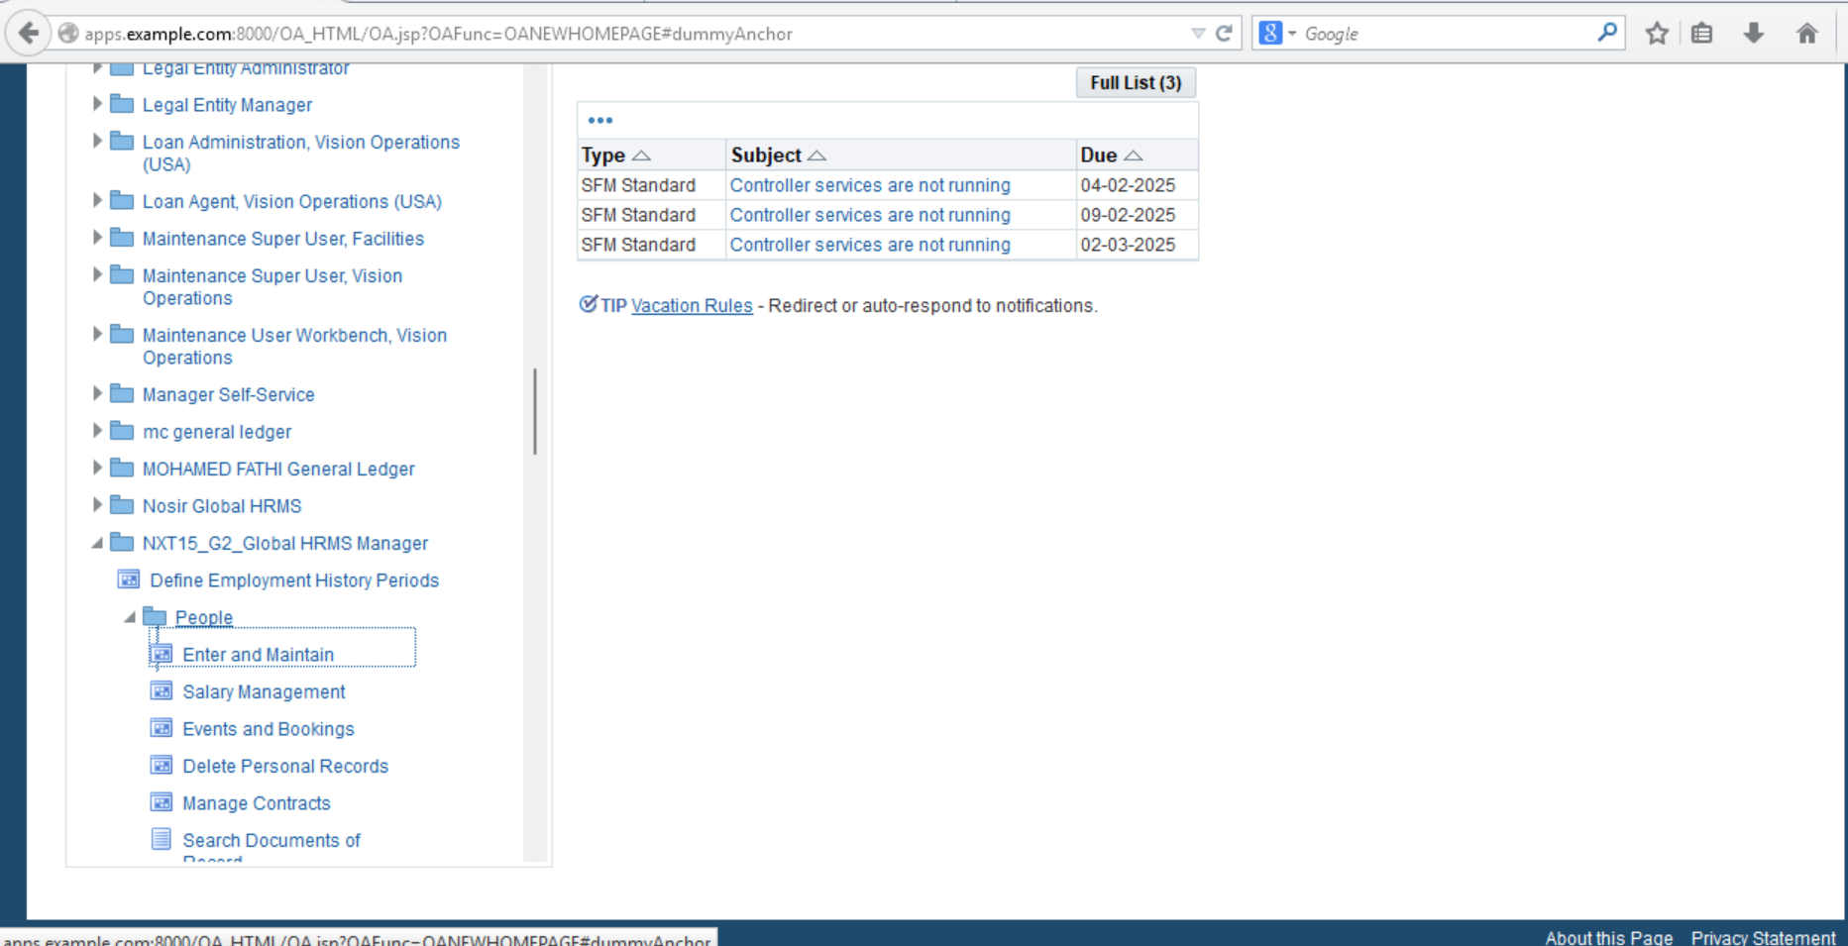
From people >>Enter and maintain

Slide 30
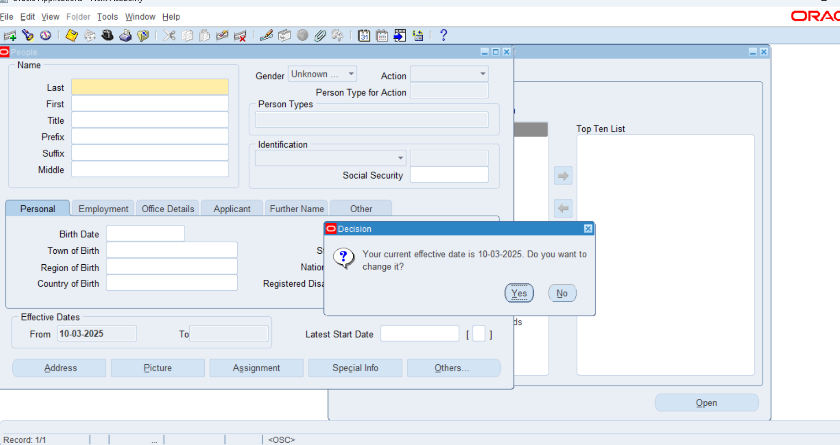
Change date if needed

Slide 31
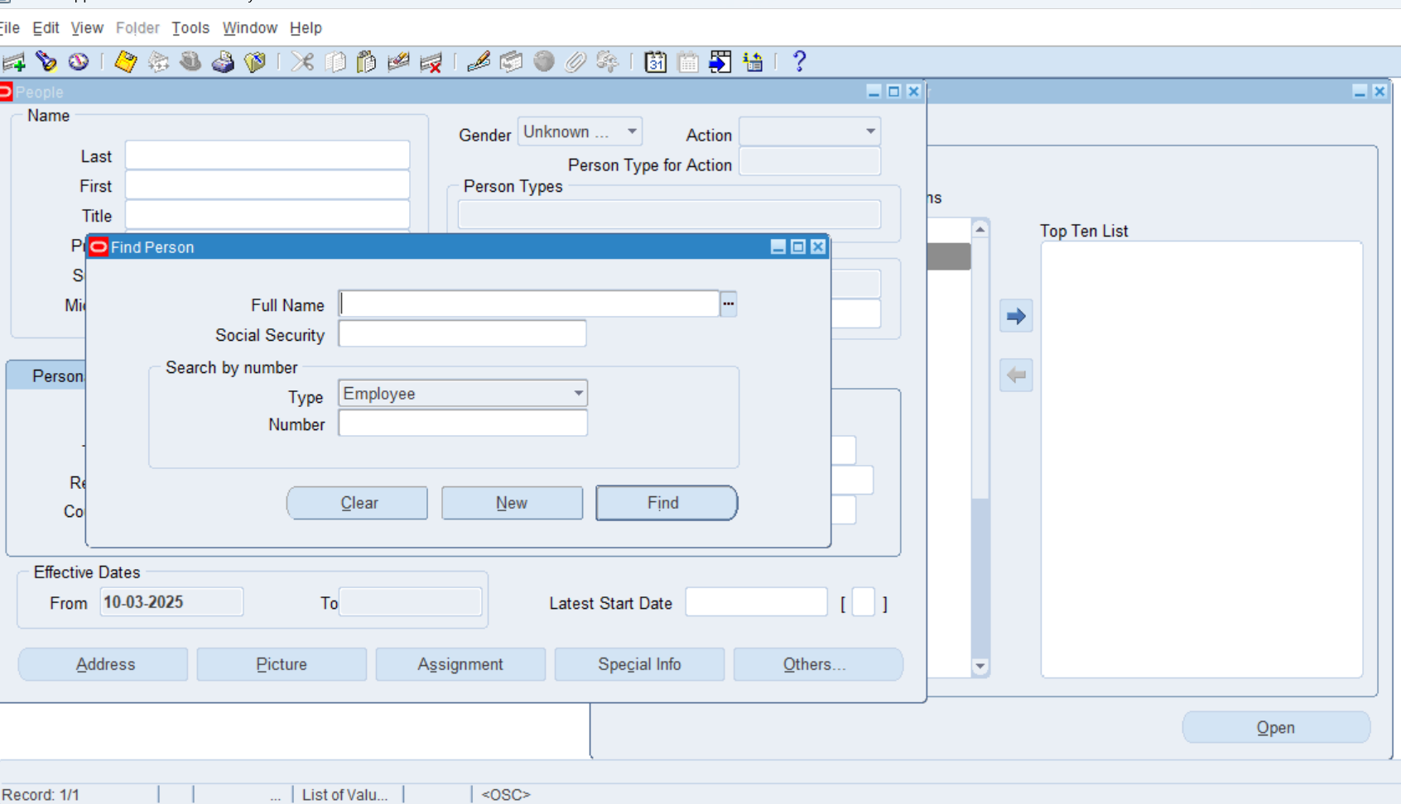
Click new employee

Slide 32
Added employee data for Mr. Mohamed Sayed Ahmed
Last | Ahmed
First | Mohamed
Title | Mr.
Middle | Sayed
action | Create employment
Person type | employee

Slide 33
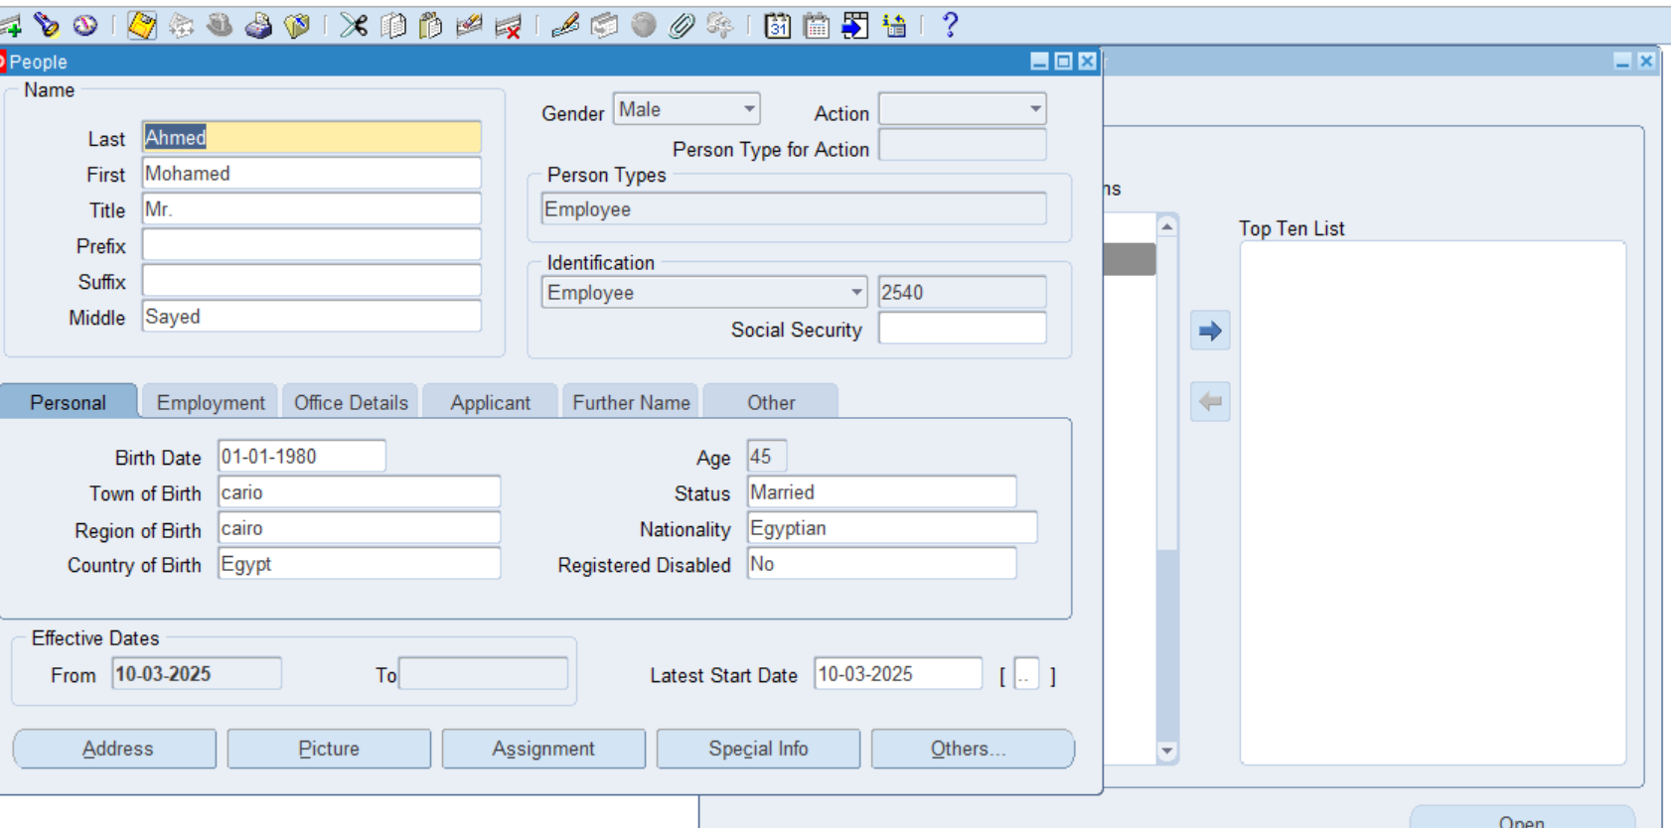
Added employee data for Mr. Mohamed Sayed Ahmed
Name | Age
Mohamed Sayed Ahmed | 45

Slide 34
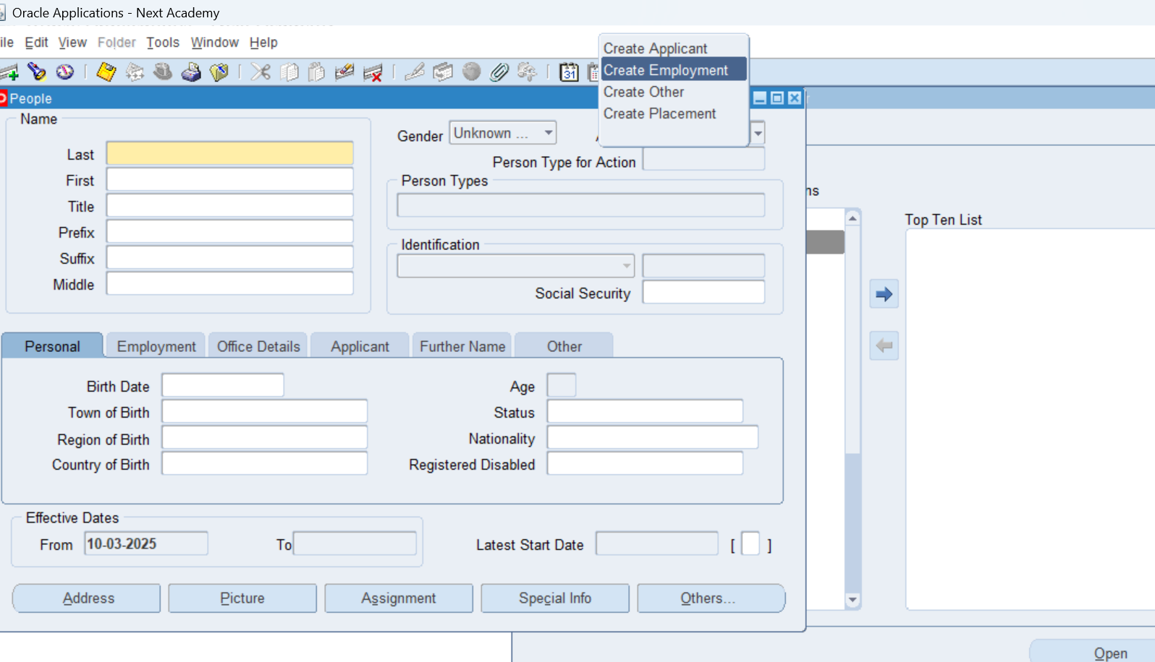

Slide 35
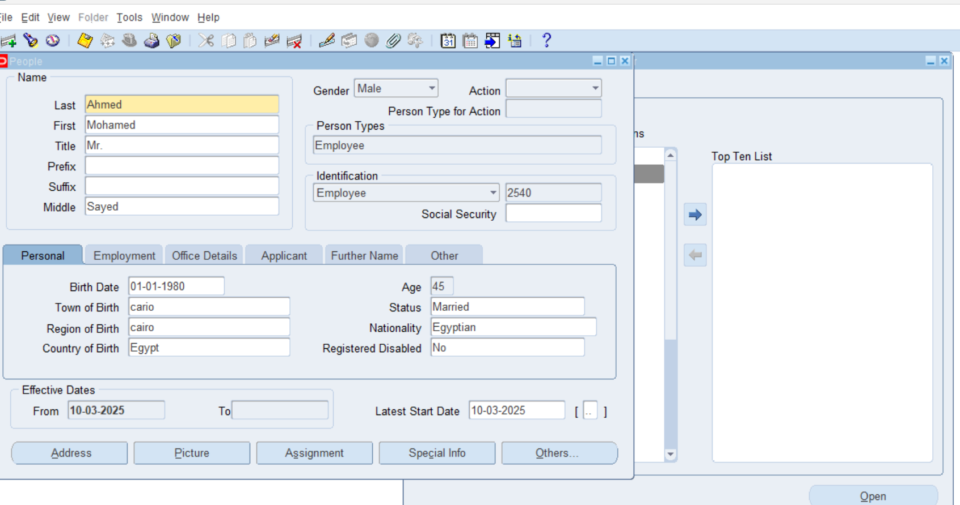
Save the data

Slide 36
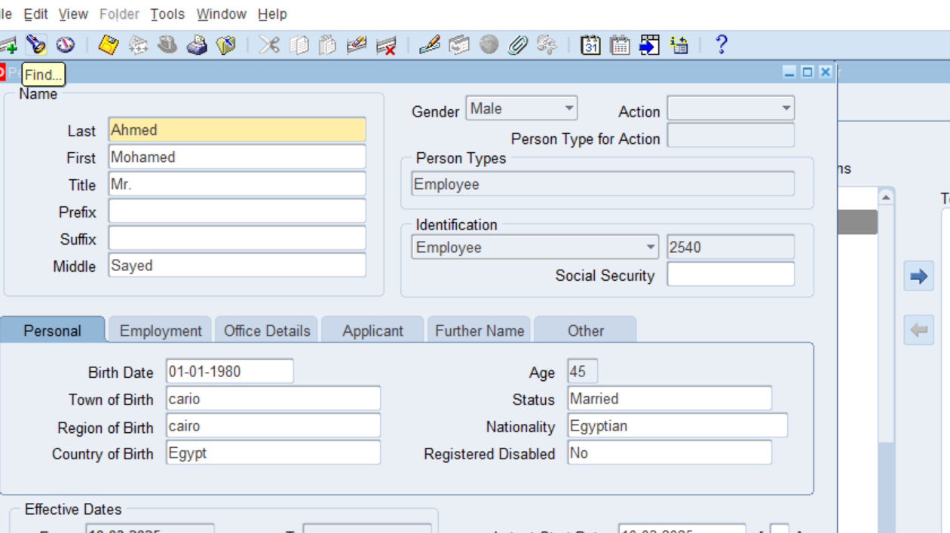
The employee created with number 2540

Slide 37
Then we will add all the employees
Number | Name | Age
2540 | Mohamed Sayed Ahmed | 45
2541 | Nada Omar Mohamed | 25
2542 | Omnia Mohamed Ayman | 27
2543 | Ahmed Mustafa Islam | 38
2544 | Fares Ibrahim Omar | 50
2545 | Radwa Gamal Mohamed | 23
2546 | Amir Waheed Saeed | 42
2547 | Cristina Raouf Sobhy | 34
2548 | Esraa Mohamed Abdullah | 24
2549 | Reham Refaat El-Hosseiny | 22

Slide 38

assignment

Slide 39
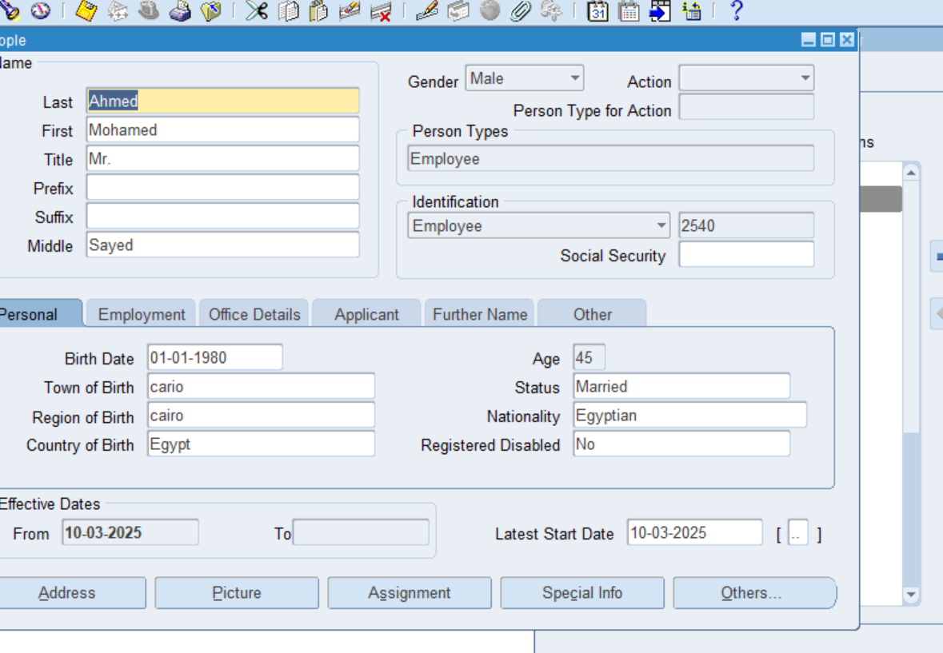
assignment

Slide 40
assignment
Number | Name | Age | Jop | Position | Organization | Grade
2540 | Mohamed Sayed Ahmed | 45 | Accountant | Finance Accountant | Finance | C-1

Slide 41
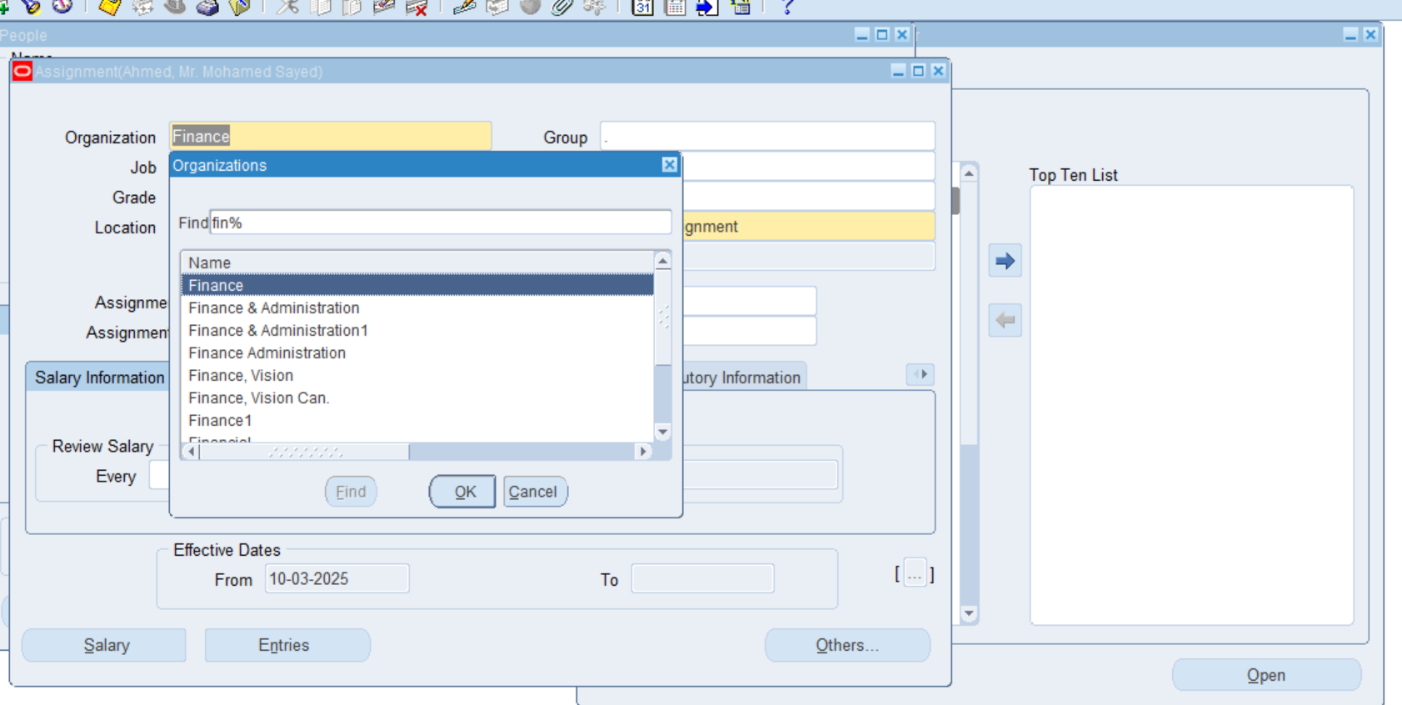
Select the organization / finance

Slide 42
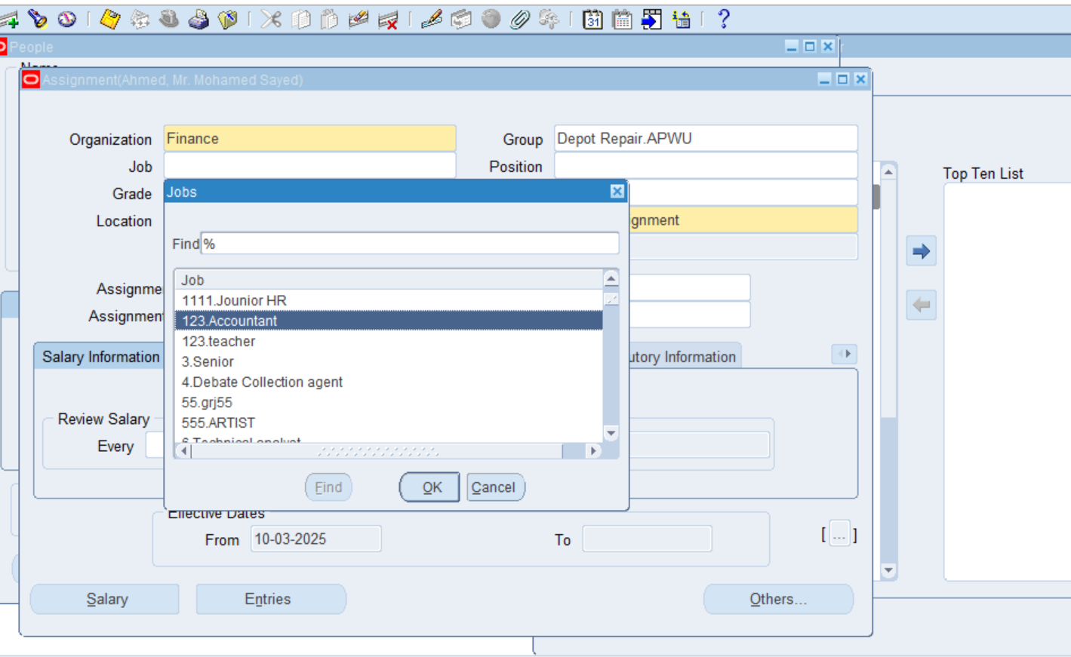
Select the job

Slide 43
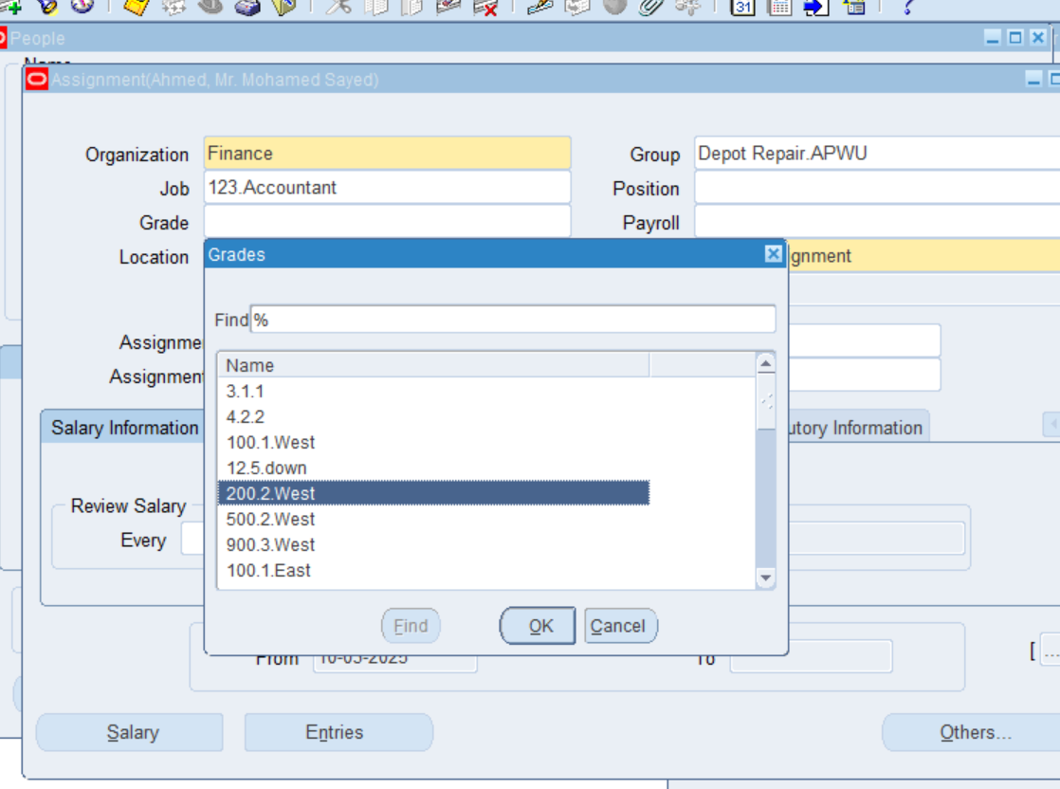
Select the grade

Slide 44
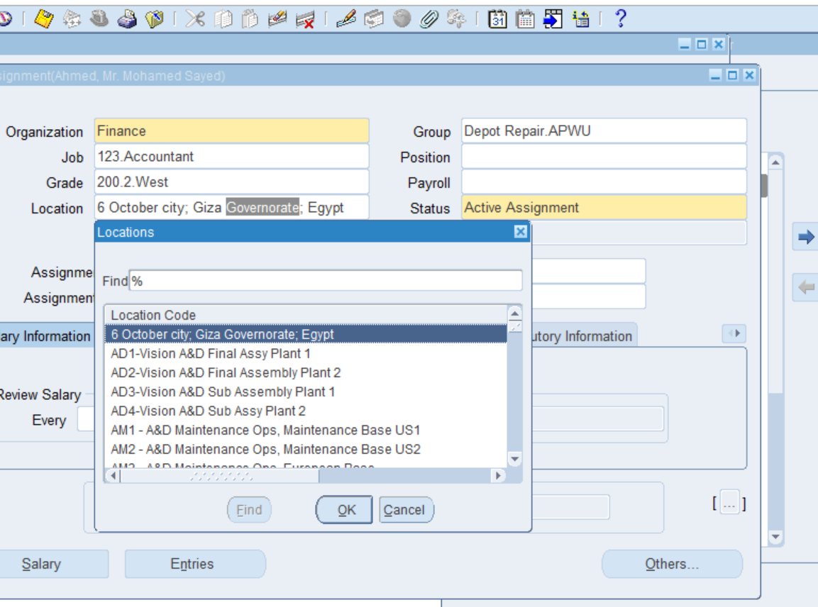
Select the location

Slide 45
Select the location

Slide 46
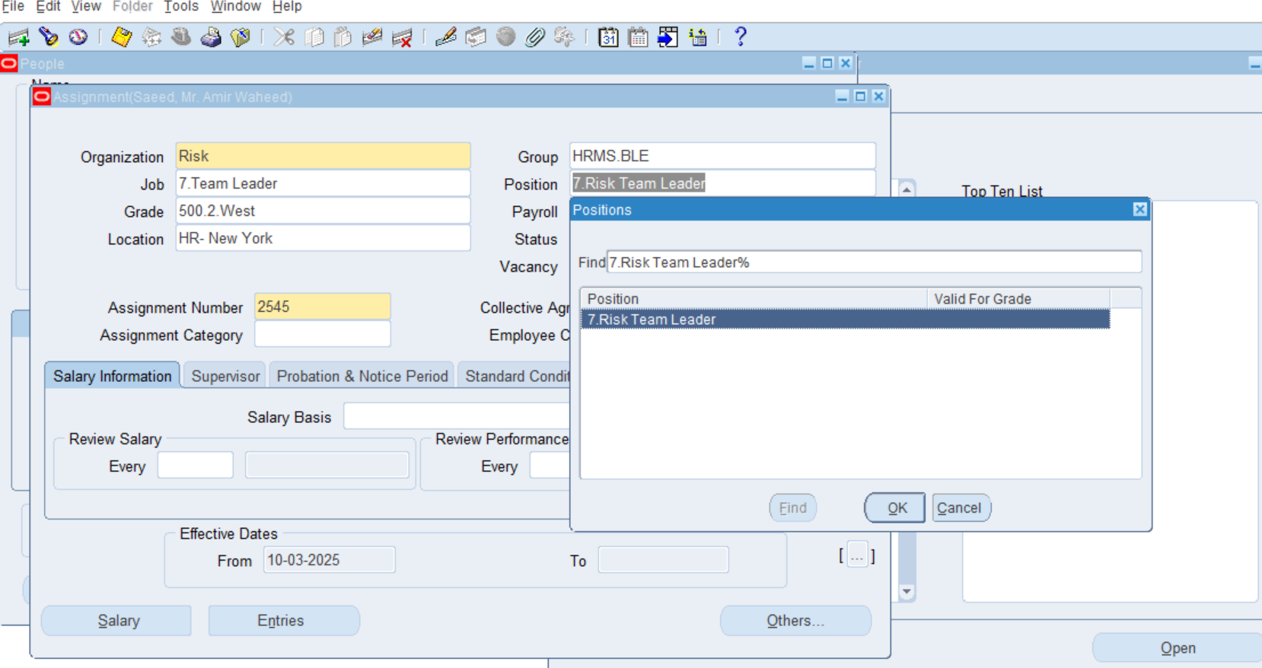
Select the position

Slide 47
Assignment for all the employees
Number | Name | Age | Jop | Position | Organization | Grade
2540 | Mohamed Sayed Ahmed | 45 | Accountant | Finance Accountant | Finance | C-1
2541 | Nada Omar Mohamed | 25 | Senior | Sales Senior | Sales | A-2
2542 | Omnia Mohamed Ayman | 27 | Call centre | Customer service call centre | Customer service | B-1
2543 | Ahmed Mustafa Islam | 38 | Debate collection agent | Credit control Debate collection agent | Credit control | B-2
2544 | Fares Ibrahim Omar | 50 | Manager | Business management Manager | Business Management | C-2
2545 | Radwa Gamal Mohamed | 23 | Technical analyst | Project management Technical analyst | Project Management | A-2
2546 | Amir Waheed Saeed | 42 | Team leader | Risk Team leader | Risk | B-1
2547 | Cristina Raouf Sobhy | 34 | Supervisor | Operation Supervisor | Operation | B-2
2548 | Esraa Mohamed Abdullah | 24 | Recruter | HR Recruter | HR | A-1
2549 | Reham Refaat El-Hosseiny | 22 | Database entry | Information Technology Database entry | Information Technology | A-1

Slide 48
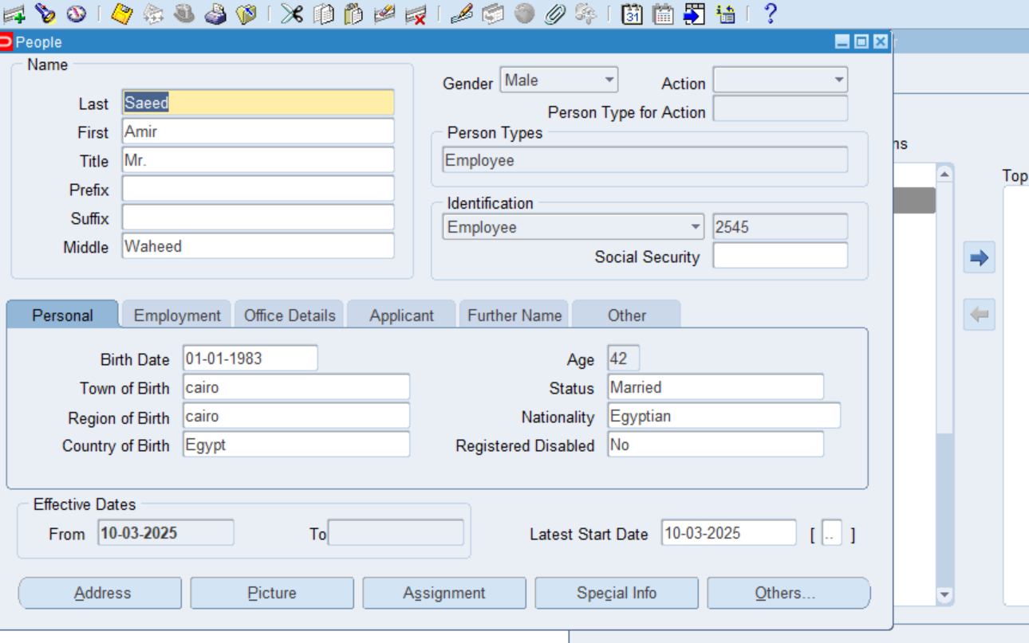
Add the address

Slide 49
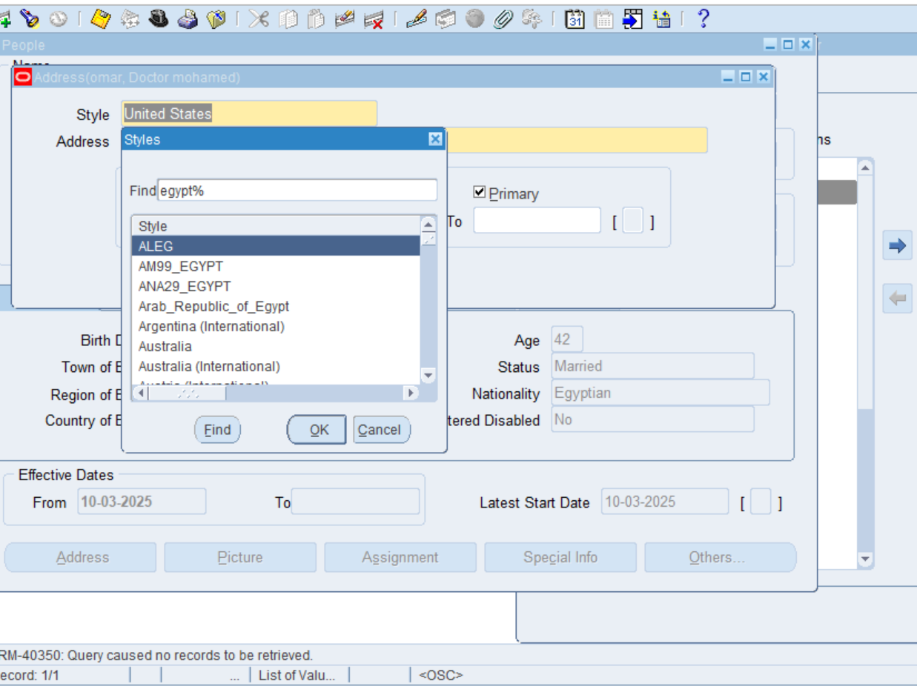
Select style -Egypt

Slide 50
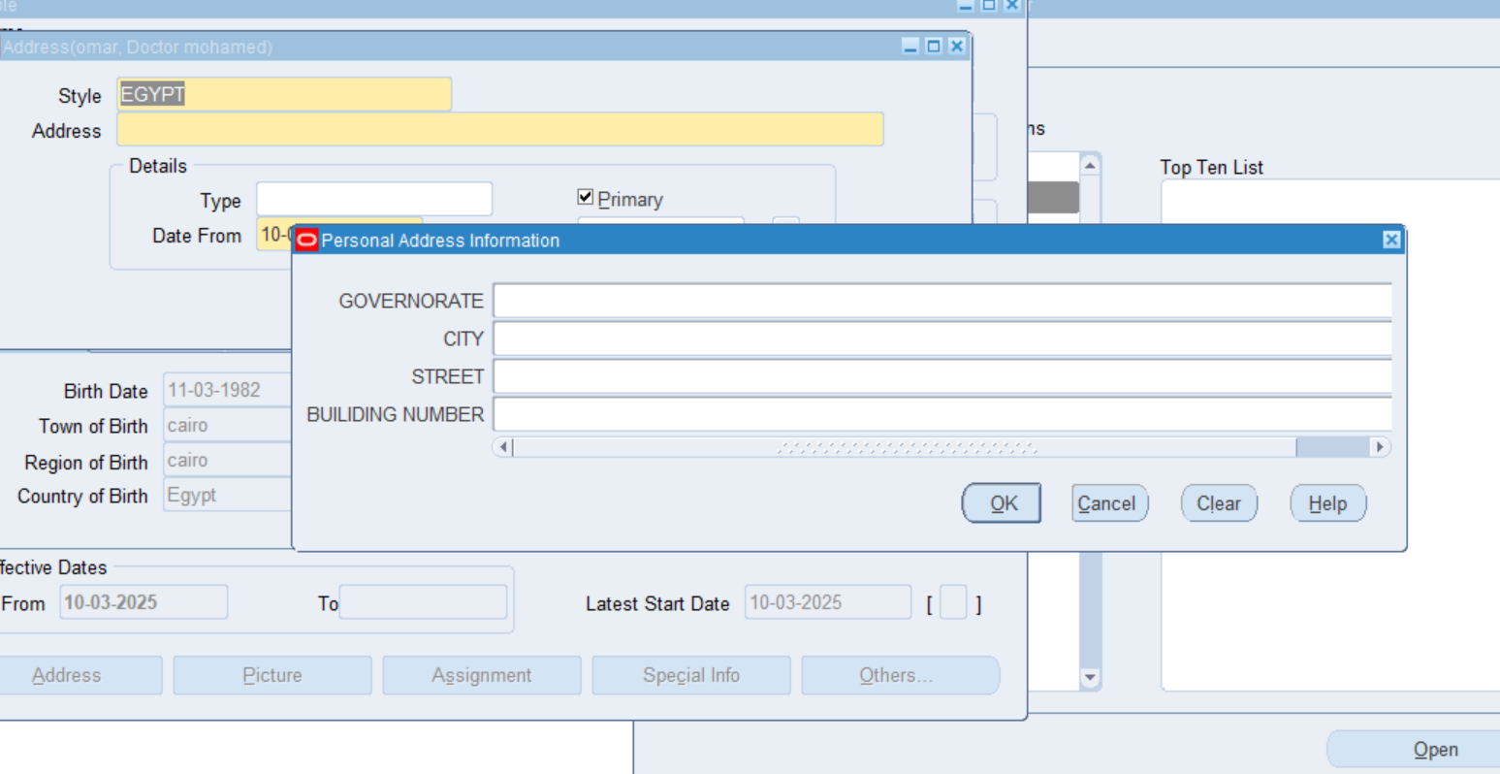
Personal address information

Slide 51

Fill it with data

Slide 52

Address type – work location address

Slide 53
4) special information

Slide 54

4) special information

Slide 55

Certifications

Slide 56

Fill it

Slide 57

Save it

Slide 58

Communication skills

Slide 59

Skill type – presentation – level excellent

Slide 60

5) others phone, contact, qualification

Slide 61

Select – others

Slide 62

Phones

Slide 63

Type- phone number

Slide 64

Mobile

Slide 65

Fill the data

Slide 66

Others / qualifications

Slide 67

Bachelor degree

Slide 68

status

Slide 69

Others / contact

Slide 70

Relationship type

Slide 71

Final and save

Slide 73

Payroll System Configuration Guide

Slide 74
Payroll System Configuration Guide
1
Monetary Units Configuration
2
Payment Methods Configuration
3
Payment Types Setup
4
Consolidation Sets
5
Payroll Definition
6
Element Definition
7
Element Links and Salary Bas

Slide 75

Monetary Units Configuration
Path: Payroll >> Monetary Units

Slide 76



Find Currency

Slide 77


Define Currency Basics
Add Currency Denominations

Slide 78

After entering Name (e.g., "5 POUND") and Value (e.g., "5.00"):
Click "Save" (or "Apply") button before adding the next unit.
Repeat for all denominations (10 POUND, 20 POUND, etc.).

Slide 79

Payment Methods
path:
payroll > payment method

Slide 80



Bank Payment Method Setup

Slide 81

Cash Payment Method Setup

Slide 82

payment types
path:
payroll >payment types

Slide 83




Slide 84


Consolidation set
path: payroll>>consolidation

Slide 85


Define payroll
path:
payroll> description

Slide 86
Elements of Payroll
Basic Salary
Overtime NX
Parking
Tax
Gross Salary
Sick Leave
Absence
Accrual NX

Slide 87



Define element
path: payroll>> description

Slide 88


Define element

Slide 89


Define salary basis
path:
total compensation >basic>salary basis

Slide 90

Define element link
path:
total compensation>>basic>element link

Slide 91


Linking the employee to the payroll
from people enter and maintain

Slide 92

Add new salary

Slide 93

Element entries

